Slide 1

Introduction to greenhouse gas removal methods
Chris Stark – UK Committee on Climate Change
Notes:
USE: 1.10 – 1.56 of the recording we took before (ending “carbon dioxide and carbon”)
RECORD:
“I am going to run through 6 of the main green house gas removal methods, their status and potential, and explain some of their pros and cons. The pros and cons I will cover are examples and are not comprehensive.
Now there are other methods – I want to be upfront about that - but the other methods are more speculative at the moment. What I mean by that is that work still needs to be done to enable them to be used at scale and to ensure that the risks associated with them can be managed properly.
Because of that we felt it was most important to understand what you thought as an assembly about some of the main contenders for how we might do these greenhouse gas removals. This is why I’m going to focus six methods only.”
Moving on to slide 2.”

Slide 2

Forests and better forest management
Infographic from the Royal Society and Royal Academy of Engineering (2018)
Notes:
RECORD:
The first method I want to talk about is growing forests and woodlands. This is perhaps the simplest of the removal methods.
When trees grow they naturally absorb carbon dioxide from the atmosphere.
It takes a forest about 10 years to ramp up to absorbing the maximum amount of carbon it can
And after 20-100 years the forest reaches what we call maturity, and the amount of carbon it can absorb starts to slow down
We can grow more forests and woodlands – and we can manage our forests better.
e.g. there are ways to remove some tree growth to make room for other trees to grow more successfully. This allows you to increase the overall amount of carbon that can be stored in that forest
Moving on to slide 3.

Slide 3
Forests and better forest management
Potential advantages | Potential disadvantages
Costs are relatively low Potential to store carbon is well known and understood Could store significant amount of carbon dioxide | It takes time for trees to mature (at least 10 years) Uses land that could be used for other activities Could have a negative impact on biodiversity
3
Notes:
RECORD:
If that’s what can be done with forests and woodlands, what are the potential advantages and disadvantages of doing greenhouse gas removal in this way.
[Talk through the table briefly. When get to land use, say that Jim is going to tell them what the group looking at food, farming and land use when we were in Birmingham said about that.
Then run through what’s underneath table]
Moving on to slide 4.

Slide 4
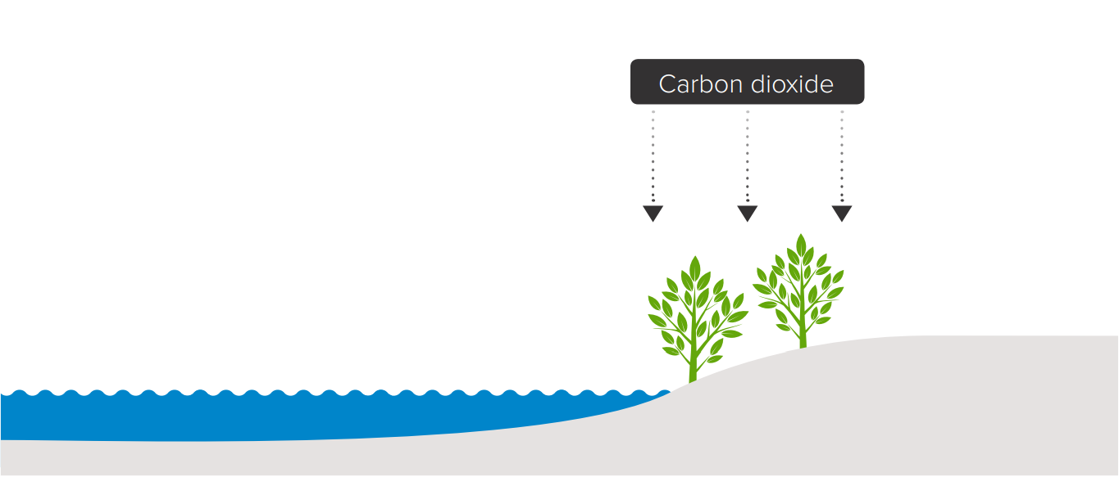
Peatlands and wetlands
Infographic from the Royal Society and Royal Academy of Engineering (2018)
Notes:
RECORD:
The second method I want to talk about is peatlands and wetlands. Like forests this is another natural way of doing greenhouse gas removals.
Peatlands and wetlands are the damp, wet natural habits that we find all around the UK. These habits naturally absorb a lot of carbon. But if they dry out then they release that carbon back into the atmosphere.
What that means is that if we want to use these habitats as a way of removing greenhouse gases from the atmosphere then we need to keep them wet. Often that means restoring these peatlands and wetlands because agricultural practices have deliberately dried them out over time to create farmland.
Moving on to slide 5.

Slide 5
Peatlands and wetlands
Potential advantages | Potential disadvantages
We know how to restore peatlands and wetlands A quick way to store carbon at relatively low cost Could have other economic environmental benefits | Understand less about the science of storing carbon in these places for a long time Uses land that could be used for something else Limited potential: only some areas of the UK are suitable
Notes:
RECORD:
So what are some of the potential advantages and disadvantages of doing greenhouse gas removal in this way.
[Talk through table.]
FYI, I didn’t understand why the top right bullet point was a problem – I’d say either add a brief explanation or take it out.
I also wasn’t sure if labour intensive was a problem because it’s expensive and, if yes, whether or not this option is still cheaper than others
Moving on to slide 6.

Slide 6
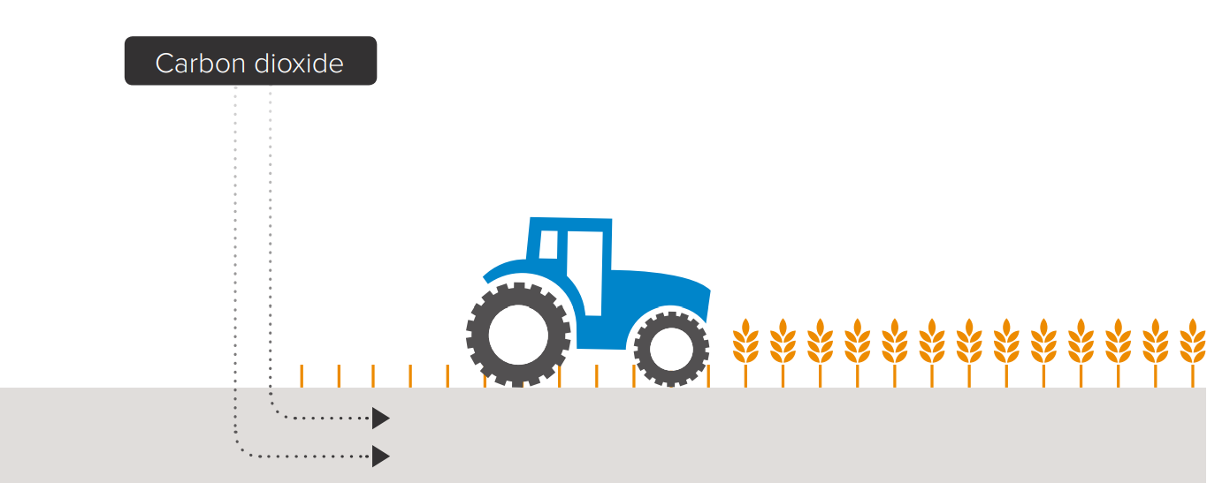
Enhancing the storage of carbon in soil
Infographic from the Royal Society and Royal Academy of Engineering (2018)
Notes:
RECORD:
The next method I’m going to talk about is enhancing the storage of carbon in the soil.
Again, like with forests, peatlands and wetlands, the soil naturally stores carbon.
How much carbon the soil can store is affected by:
How often we disturb the soil (e.g. how often we plough it with machines)
How much organic material is in the soil. Organic material is things that were living, like plants, that are now dead. So those of you who have gardens may have a compost heap where you put garden waste (hedge trimmings etc). You let that decay a bit and then you dig that back into the soil. That’s organic material.
If we want the soil to be able to store more carbon, we need to disturb it less and it ensure it has more organic materials in it. This is really about changing farming practices:
Changing ways that crops are grown
Reducing how often we plough the soil with machines
Using natural fertilizers rather than artificial ones
Moving on to slide 7

Slide 7
Enhancing the storage of carbon in soil
Potential advantages | Potential disadvantages
Well-understood method that can be implemented now Could have a low cost Could have other economic and environmental benefits | Requires changes to modern farming practices Farmers may need financial support from government Could reduce amount of food that can be produced from a given area of land
7
Notes:
RECORD:
So what are some of the potential advantages and disadvantages of doing greenhouse gas removal in this way.
[Talk through table.]
Moving on to slide 8.

Slide 8
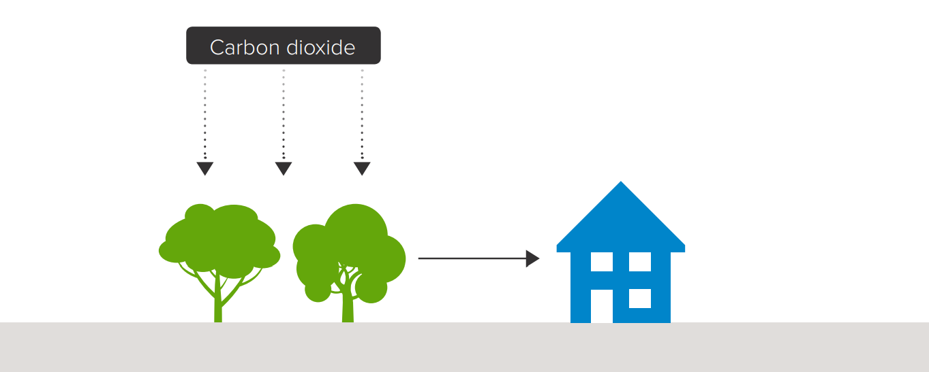
Using wood in construction
Infographic from the Royal Society and Royal Academy of Engineering (2018)
Notes:
USE: 10.05 (starting “now I’m going to move on to …”) – 10.52 of original recording (ending “in the home”)
RECORD: Moving on to slide 9

Slide 9
Using wood in construction
Potential advantages | Potential disadvantages
Wood has been used in construction for centuries A relatively low cost way to store carbon Reduces carbon emissions by replacing other carbon-intensive materials | Requires changes to modern building practices May mean very tall buildings are not possible Scale might be limited by availability of sustainable sources of wood
9
Notes:
RECORD:
So why may this be, or not be, a good idea.
[talk through table]
Moving on to slide 10.

Slide 10
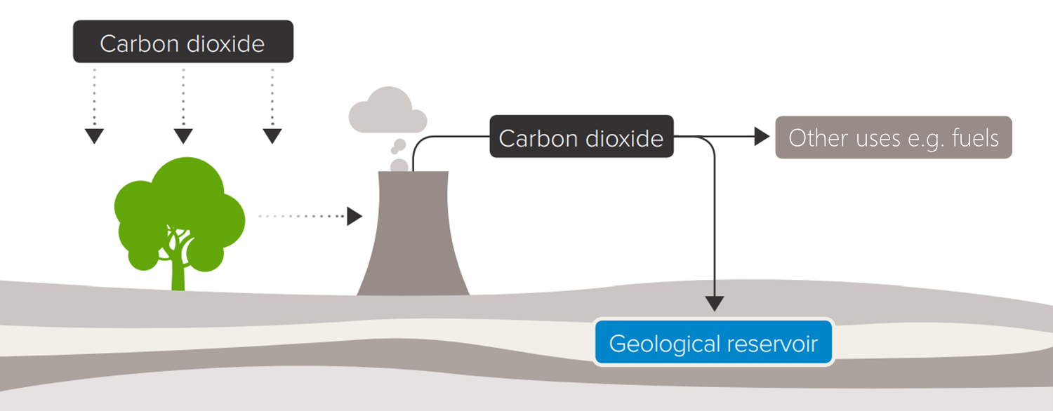
Bioenergy with carbon capture and storage (BECCS)
Infographic adapted from the Royal Society and Royal Academy of Engineering (2018)
Notes:
USE: 11.52 – 13.59
RECORD: Now, don’t worry if you haven’t followed all of that. It is complicated. And what you really need to understand about this method are the potential pros and cons of using it. Moving on to slide 11.

Slide 11
Bioenergy with carbon capture and storage (BECCS)
Potential advantages | Potential disadvantages
Could capture and store a significant amount of carbon dioxide emissions Combines technologies that are well understood Lots of storage space in the UK (e.g. oil and gas fields) | Likely to have high costs, at least initially Uses land that could be used for other activities Need to ensure that carbon dioxide storage is secure
Notes:
USE: 11.52 – 13.59
RECORD: Now, don’t worry if you haven’t followed all of that. It is complicated. And what you really need to understand about this method are the potential pros and cons of using it. Moving on to slide 11.

Slide 12
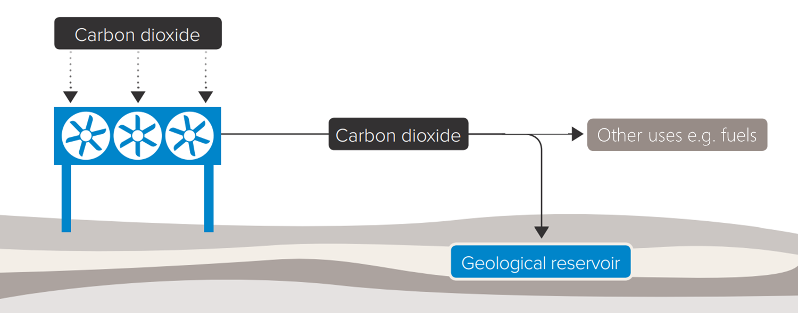
Direct air capture and carbon storage
Infographic adapted from the Royal Society and Royal Academy of Engineering (2018)
Notes:
RECORD: The final method I am going to talk about is direct air capture and carbon storage. This is one of the newest technologies.
USE: 15.42 (starting “and here a machine…”) – 16.15 (ending “as we did with the previous method.”)
RECORD: Moving on to slide 13

Slide 13
Direct air capture and carbon storage
Potential advantages | Potential disadvantages
Could capture and store a significant amount of carbon dioxide emissions Lots of storage space in the UK (e.g. oil and gas fields) A variety of technical options are being developed | Technologies are very new and experimental Could require a large amount of low carbon electricity Current costs are very high, though they could fall as technology improves
13
Notes:
RECORD: [Run through table.]
USE: 20.23 (starting “so that concludes”) – the end.

