Slide 1
Low carbon electricity options (3)
1
Jim Watson
Expert Lead and Professor of Energy Policy,
UCL Institute of Sustainable Resources

Slide 2
Nuclear power
2
Civilian nuclear power generation in the UK since 1956
Nuclear power generated 17% of UK electricity in 2019
8 nuclear plants are operating in the UK; 11 older plants have closed
One new plant is under construction at Hinkley C in Somerset
Sizewell B nuclear power plant (Suffolk)

Slide 3
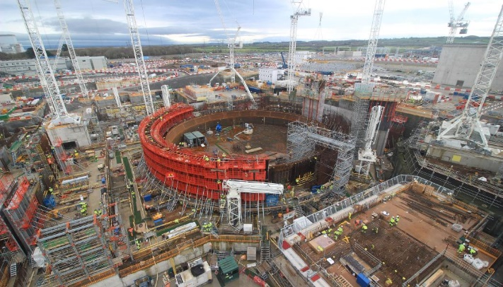
Nuclear power
3
Potential contribution of nuclear power is large: 10 plants like Hinkley C could generate 75% of UK electricity
If no more plants are built, nuclear share of generation will continue to fall
Limiting factors include costs, public acceptability and waste management
New nuclear in the UK costs over twice as much as new wind power
Hinkley C nuclear power plant

Slide 4
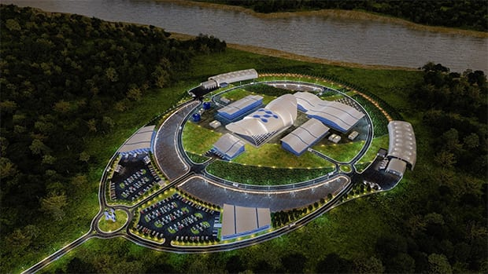
Nuclear power
4
Future nuclear technologies include
  Small modular reactors
  Advanced modular reactors
Costs and timescales of these new technologies are very uncertain
Research and development is underway, but government funding will be required if they are to be built
Artist’s impression of small modular reactor

Slide 5
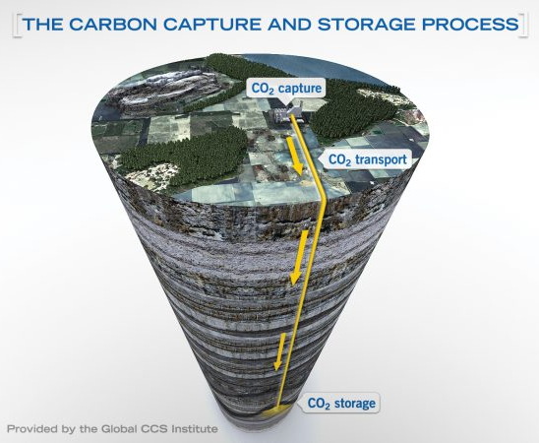
Fossil fuels with carbon capture and storage (CCS)
5
Carbon capture and storage can capture ~90% of emissions from fossil fuel electricity generation
Fossil fuels generated 43% of UK electricity in 2019, without CCS
CCS technology is at an early stage
Several full-scale plants operating, including two power plants in the USA and Canada

Slide 6
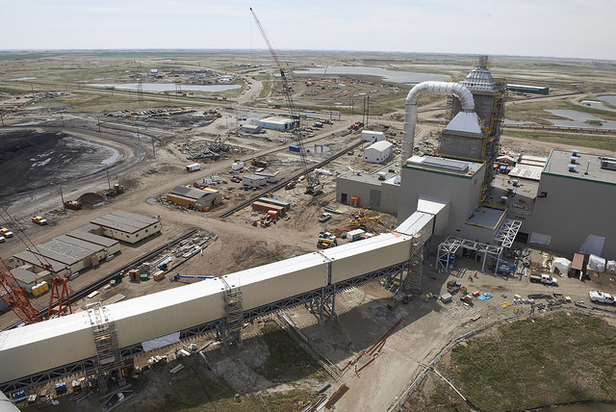
Fossil fuels with carbon capture and storage (CCS)
6
Potential contribution of fossil fuel with CCS is large in the UK
Significant resources for CO₂ storage, e.g. under the North Sea
Long-term monitoring required to ensure that leakage is minimal
Costs are likely to be high for first full-scale plants: at least twice as high as wind and solar
Boundary Dam coal CCS plant (Canada)

