Slide 1
Climate Assembly UK Heat as a Service
Matthew Lipson
Business Lead: Consumer Insight
February 2020

Slide 2
It’s hard for consumers to know what is best?
District heat
Hydrogen boilers
Solar panels
Consumers
Local authorities
Heat pumps
Insulation
Community groups
Businesses
Batteries

Slide 3
Rapid change is possible if people want it
1970
2014

Slide 4
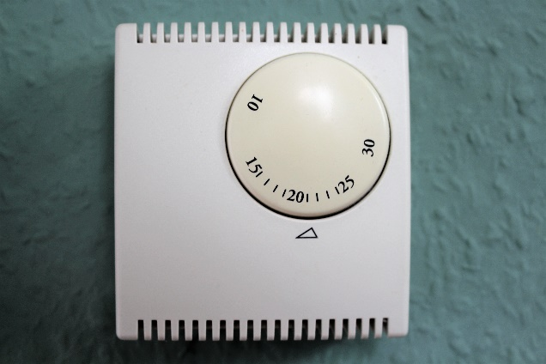
Most people put up with problems
Poor control
Draughts
Damp
Overheating

Slide 5
People want very different things from their heating
Out all day
Popping in and out

Slide 6
The ‘best’ option varies from place to place
What networks are there already?
How well insulated are the homes?
How many homes are there?
Electricity
Gas
District heat

Slide 7
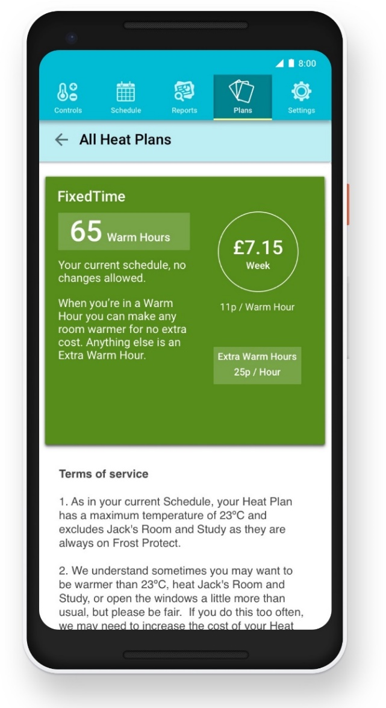
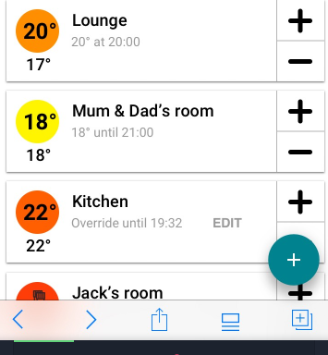
Couldn’t heat be more like TV or mobile?
What if we bought heat as a service?

Slide 8
As long as you can get comfortable, for a fair price, do you really care what heating system you have?
What oven was this cooked in?

Slide 9
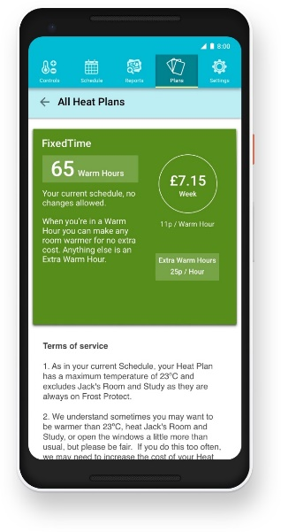
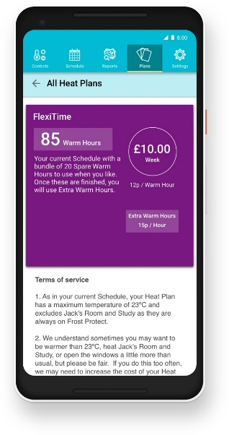
People can pick different plans, and leave their provider to make it low carbon

Slide 10
Could heat as a service help us support people who are struggling?
Struggle to pay
Expensive to heat

Slide 11
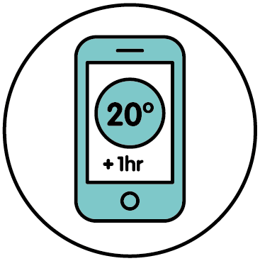
How can we make this happen?
What do we need to do?
How should we do it?
Make low carbon heating great
(like Electric Vehicles)
Give business a reason to innovate: a carbon MOT for your home?
Check solutions work well for people
Create Living Labs to test and learn
Make sure everyone can enjoy the benefits
Make it affordable with funding and finance
Help people choose what’s right for them
Make sure each local area has a plan

Slide 12
Matthew Lipson
matthew.Lipson@es.catapult.org.uk

