Slide 1
Net zero agriculture by 2040
Ceris Jones, NFU
Climate Assembly, 9th February 2020

Slide 2
Net zero agriculture by 2040
Producing the most climate-friendly food in the world by:
Reducing our emissions by being more efficient

Slide 3
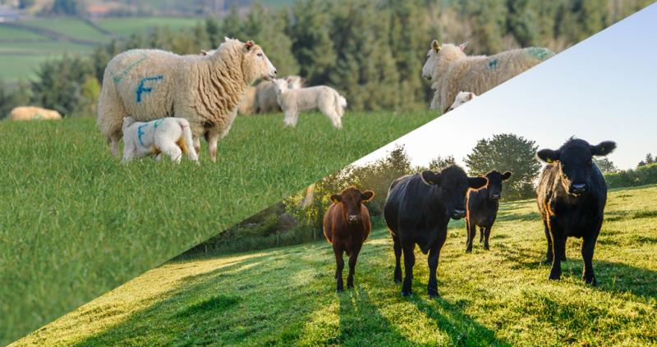
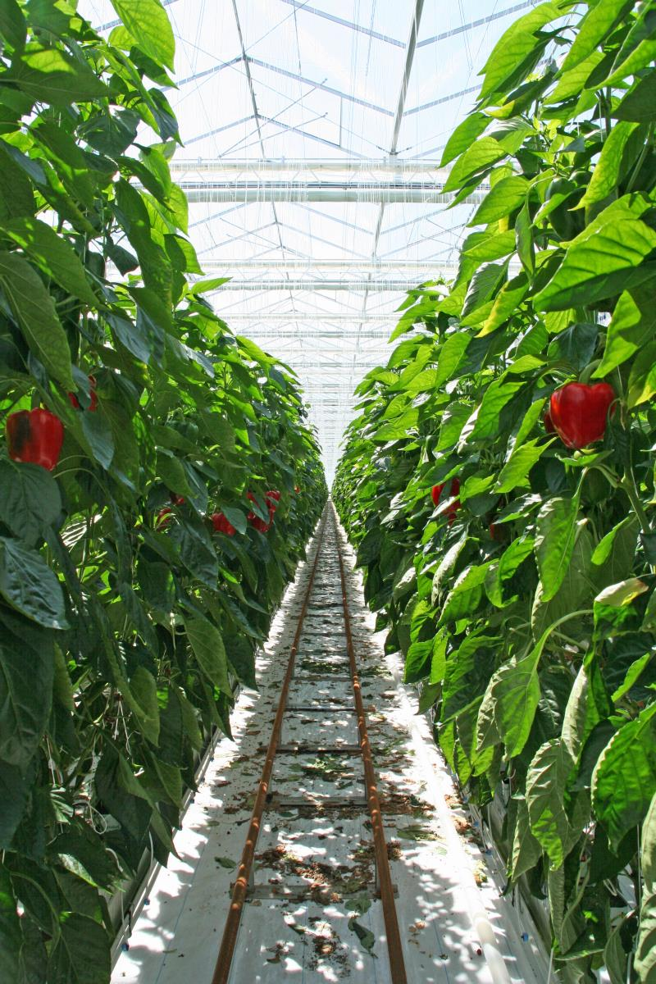
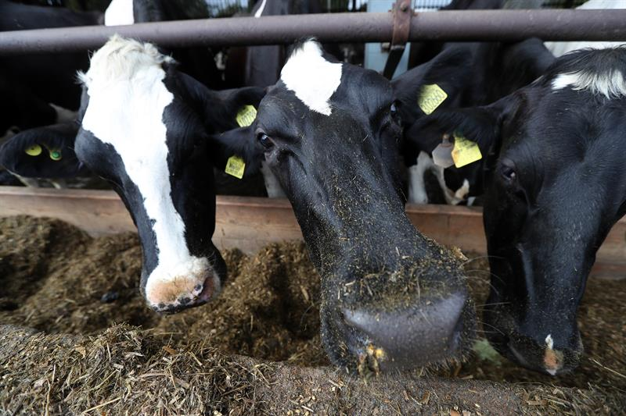
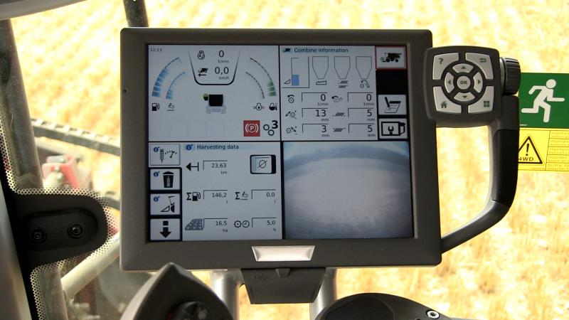

Slide 4
Net zero agriculture by 2040
Producing the most climate-friendly food in the world by:
Reducing our emissions by being more efficient
Storing carbon on farmland

Slide 5
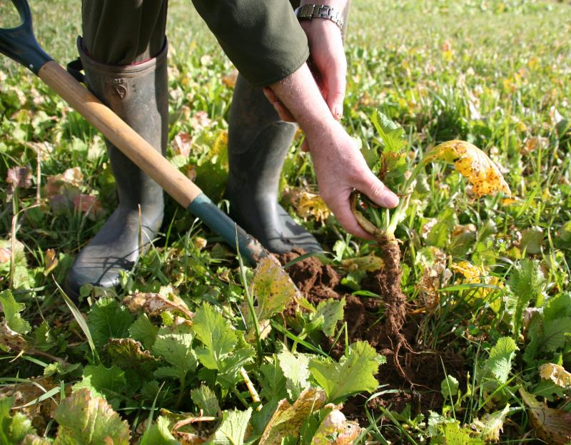
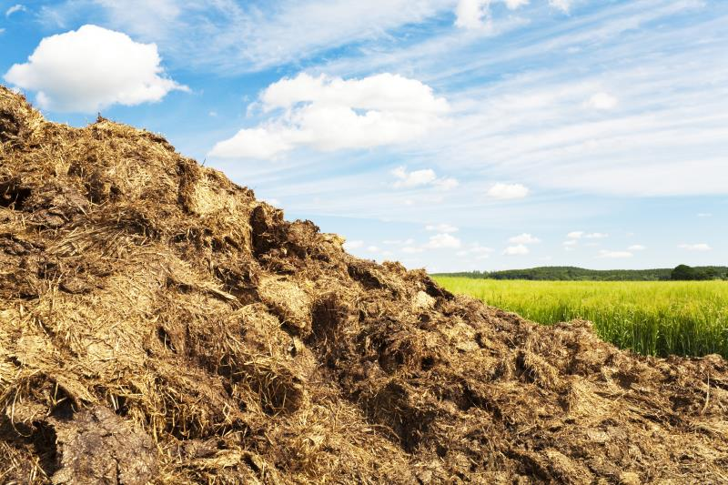
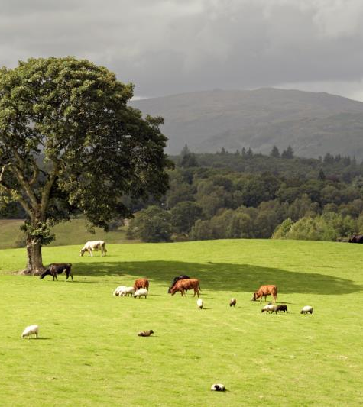
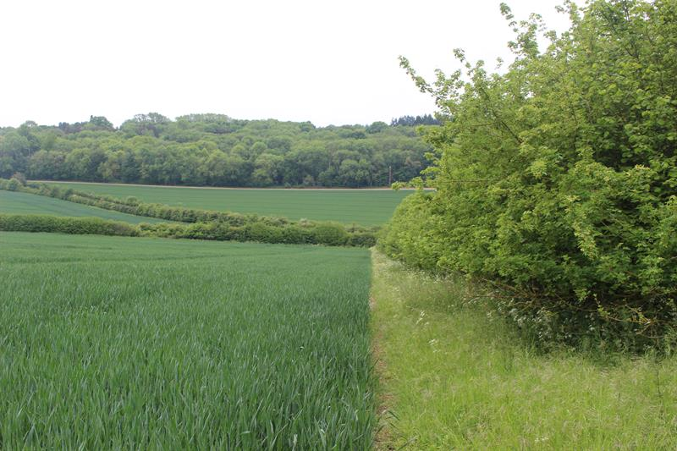
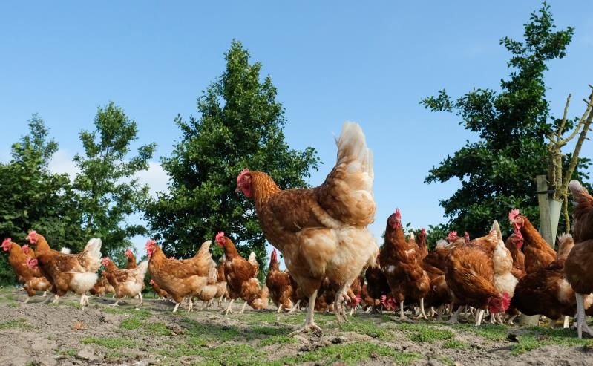

Slide 6
Net zero agriculture by 2040
Producing the most climate-friendly food in the world by:
Reducing our emissions by being more efficient
Storing carbon on farmland
Boosting renewable energy and helping to build a zero carbon economy

Slide 7
