Slide 1

What we buy
Mike Berners-Lee

Slide 2
Thank you!
for being in this Assembly

Slide 3
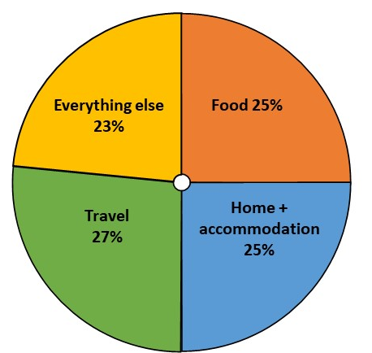
Average UK person’s Greenhouse Gas Footprint: 12.7 tonnes CO₂e per year

Slide 4
Average UK person’s Greenhouse Gas Footprint: 12.7 tonnes CO₂e per year
Everything else
23%
Food 25%
Travel
27%
Home + accommodation
25%

Slide 5
Physical things we buy (other than food)
Everything else
23%
Food 25%
Travel
27%
Home + accommodation
25%

Slide 6
The carbon footprint of things we buy
Manufacture
+
Use
+
End of life

Slide 7

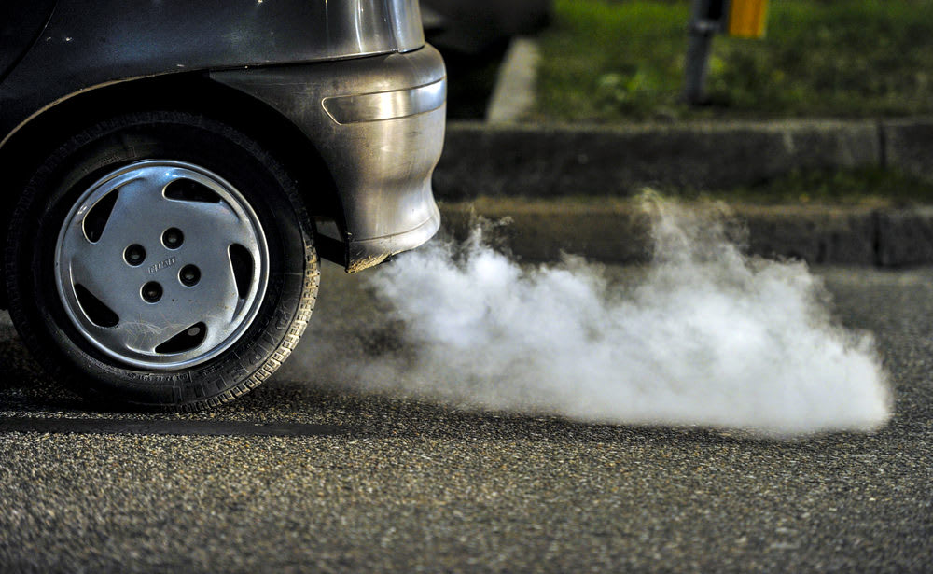
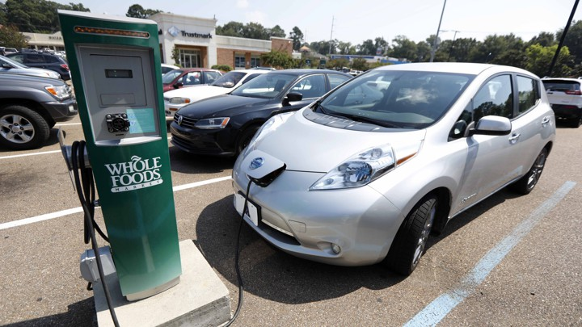
Gas Boiler
Petrol car
Electric car
+
Use
+
Manufacture
End of life
Efficiency is critical.
+
Use
+
Manufacture
End of life
+
Use
+
Manufacture
End of life
Efficiency is and electrification is critical but manufacture also has a big impact

Slide 8


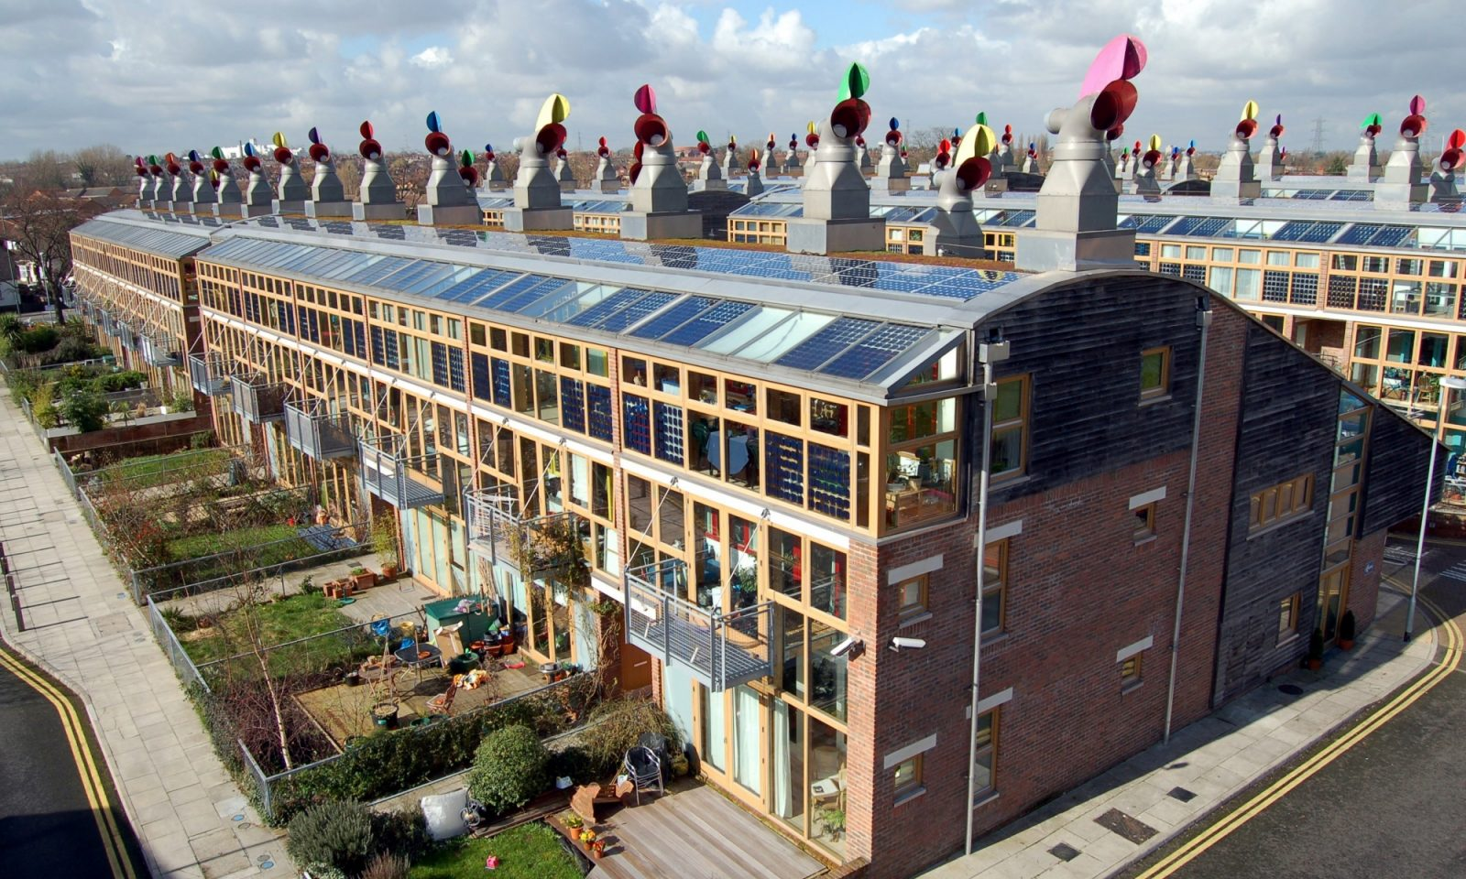
Smartphones
Furniture
Houses
+
+
Manufacture
Use
End of life
IT kit needs to last and be repairable.
+
End of life
Manufacture
Make to last, sustainable materials, repair and pass it on.
+
Construction ?
Living in the house depends on how it was built
Build zero energy homes or better and improve old ones

Slide 9
Some core materials – and ways to cut carbon
Steel
  Use less
  More recycling
  Phase out coal from production
Cement
  Alternative materials – e.g. timber frame houses.
  ‘Eco cement’
Plastic
  Carbon is not the only problem
  E.g. Glass bottles could be higher carbon but better in other ways
  Recycle
Wood
  Trees remove carbon from the air
  Must be from sustainable forestry
Batteries
  Huge issue for electric cars and also for IT
  Not just carbon

Slide 10
5 Rs - for products and packaging
Reduce
  Buy less junk
  Buy ‘pre-loved’
  Choose sustainable materials and sustainable production
  Buy quality things that are made to last.
  Share, borrow or hire
Repair (and maintain)
Re-use
  Or pass it on to someone who will reuse it
  Make it into something new
Recycle
  E.g. It takes about 20% of the carbon to recycle steel as to create it from iron ore
  Segregate everything
Recover (almost last resort)
  E.g. burn it to get some energy back

Slide 11
Everything else
23%
Food 25%
Travel
27%
Home + accommodation
25%

