Slide 1
Julie Hill
Chair, WRAP

Slide 2
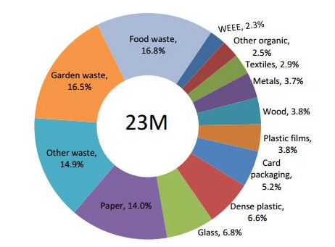

What we waste (our bins)

Slide 3
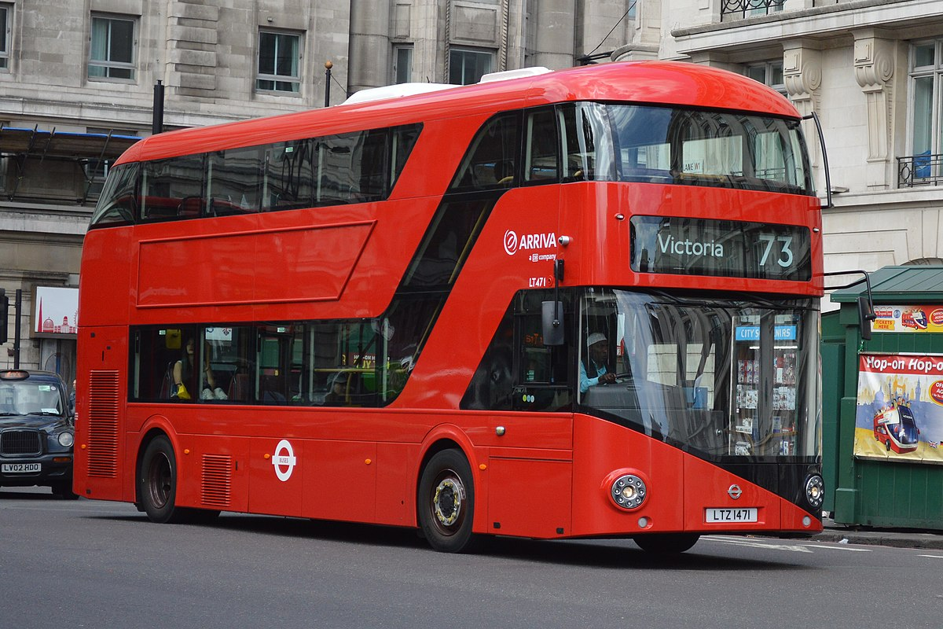
About half UK waste is recycled…
223,000,000 tonnes 18,500,000
X
Household
Industrial Etc.
=

Slide 4
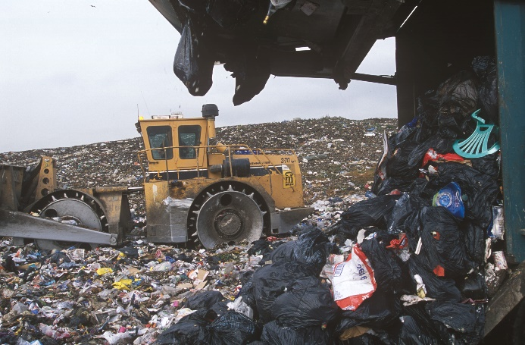
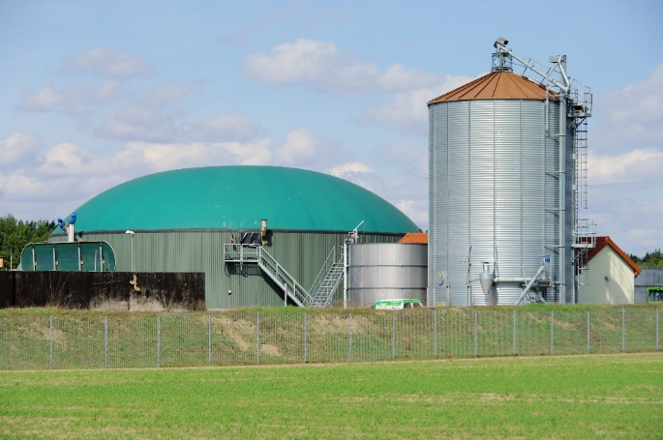
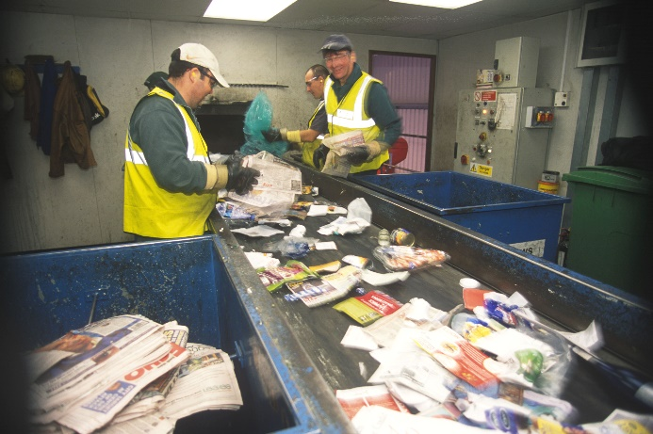
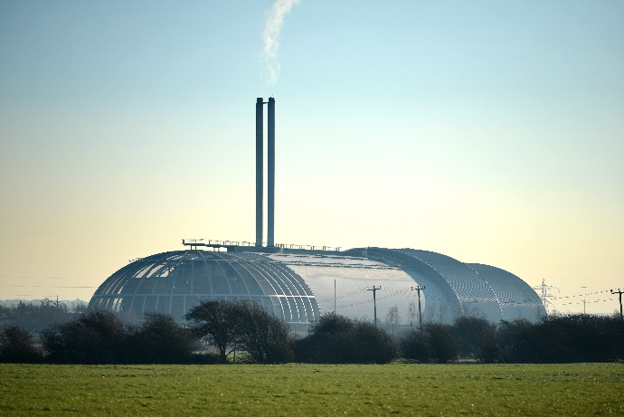
Not many waste treatment options!

Slide 5
Destinations of household waste from each country

Slide 6
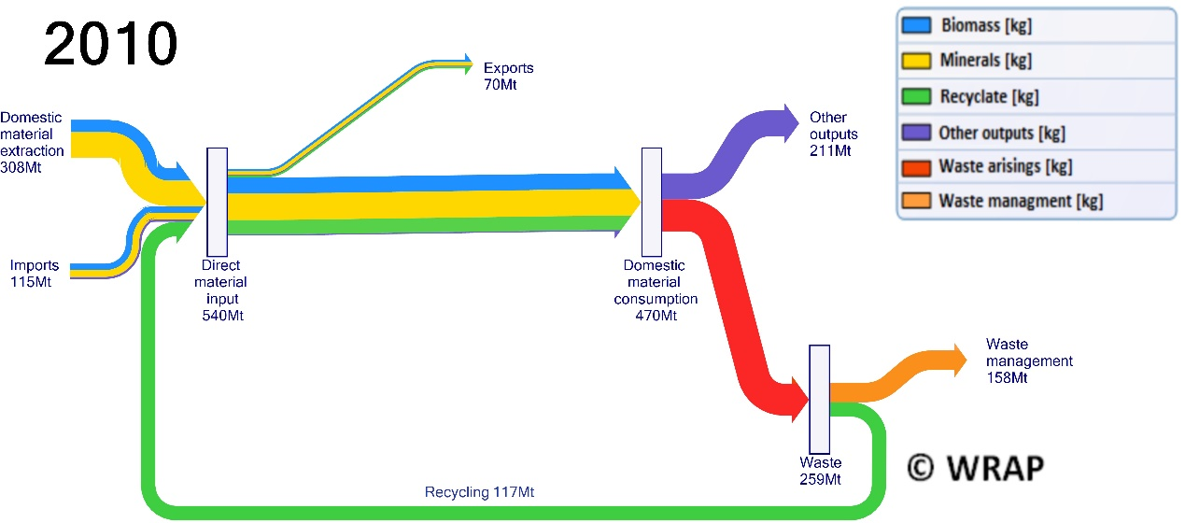
We re-use or recycle a small amount of what we consume

Slide 7
What can be achieved with recycling
Saves greenhouse gas emissions, water and materials if recycling replaces buying brand new products.
Recycling avoids the bad effects of ‘biodegradable’ waste (stuff that rots - food and garden rubbish) which breaks down in landfill to produce methane, a greenhouse gas.
Saves money for local authorities – the government has made it more expensive to send waste to landfill than to recycle it, and sometimes money is earned from selling the recycled materials as well.

Slide 8
Possible carbon savings from recycling
We can recycle:
Paper or card
Glass
Steel
Aluminium
Mixed plastics
Recycling could save around 3.5 million tonnes of CO₂ equivalent per year
Sending all our food waste to anaerobic digestion could save another half a million tonnes.
Together, equivalent to around 10% of annual aviation emissions.

Slide 9
Are there downsides to recycling?
Confusing to sort – but that could be cured by more consistent collection systems and better labeling
Have to find space in the household/office/factory
Takes some energy (transport, processing, as well as our personal energy!) but not as much as it saves
Concerns about sending some of it to other countries (plastic)
Water – might waste water if we don’t use already dirty water to clean our containers
Most important: not as good at saving carbon, water and materials as re-use, or reducing consumption in the first place
Notes:
From Billy:
Tricky one this. In the end, the industrial reprocessing is always going to use water, so the resident washing their containers is less of an issue at the actual recycling end.
It does make things more pleasant for the recycling crew / MRF operators though!
The point is valid when it comes to reprocessing - water for the process could be out of the tap, but it could be grey water (e.g. from a run-off roof or similar).

Slide 10
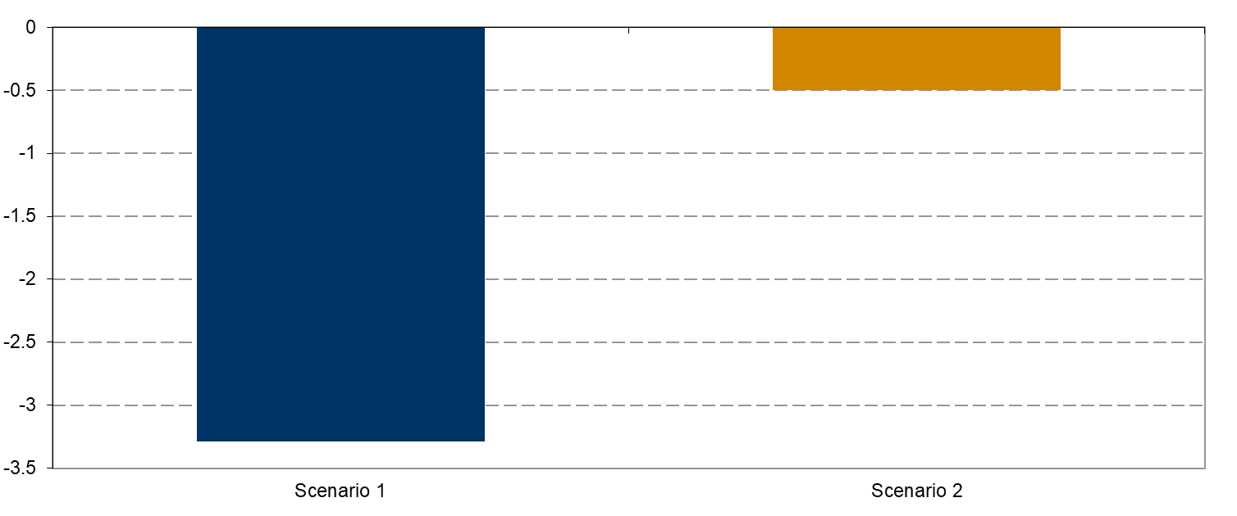
What can be achieved with re-use compared to recycling
Greenhouse gases saving per tonne electricals reused, vs the saving per tonne recycled.
Re-use
Recycling

Slide 11
And so much better not to waste...
Achieving the global goal of halving food waste by 2030 could save 6 million tonnes of CO₂ equivalent per year in the UK - 15% of aviation emissions.

Slide 12
Downsides of thermal Energy from Waste
Saves less energy overall than re-use or recycling.
Loses potentially valuable materials – ones that are not currently practical or economic to recycle.
People don’t like living near the plants.
There are more efficient ways to generate heat and electricity.
However:
It may be the only way to recover any value from some mixed, messy wastes that are hard to recycle.
And the only way to avoid landfill while we get better at reducing/
re-using/recycling.

Slide 13
Summary pros and cons of approaches
 | Greenhouse gases | Water | Keeping valuable materials | Local impact | Saves money
Less stuff/less food waste
Keep longer or send for re-use
Send for recycling (dry) |  | Dependent on material
Send for recycling (biodegradable)
Send for thermal Energy from Waste |  | N/A
Send to landfill

Slide 14
‘Circular Economy’
Just means less stuff, less waste and keeping things in use…

Slide 15
If the benefits of the circular economy are so great, why isn’t this going to happen anyway?
Many people see the sense of the idea of being ‘circular’ but:
Many different actions are required.
There are the same issues as for any new business: attracting finance and convincing customers.
We may all perceive reducing ‘stuff’ as reducing quality of life.
Businesses may see reducing ‘stuff’ as reducing income and market share, compared to their competitors.
Those who benefit may not be the same as those who bear costs.

