Slide 1
Policy options for reducing emissions from what we buy
Libby Peake, Head of resource policy
Notes:
Repeat definition of policy
Mirror image of what’s gone before

Slide 2
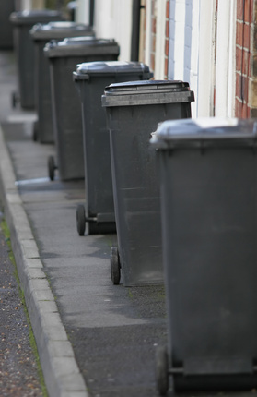
‘Pay as you throw’ or ‘save as you recycle’
Aim: To increase household recycling and decrease waste
How it works: Householders pay for the amount of waste they have in ‘black bins’, but not for recycling. Similar to what’s used for businesses and some garden waste
Notes:
Pay by bag/bin lift, , as with utilities
No longer subsidising poor behaviour of neighbours
Could be introduced with exemptions/to reflect household occupancy
Flytipping hasn’t been a problem elsewhere, including Guernsey (British Crown dependency…)

Slide 3
‘Pay as you throw’: pros and cons
Pros:
Common to many high recycling societies
Rewards good behaviour
Fairness: as with utilities you pay for what you use
Cons:
Could hit low income households
Fears over litter
Notes:
Pay by bag/bin lift, , as with utilities
No longer subsidising poor behaviour of neighbours
Could be introduced with exemptions/to reflect household occupancy
Flytipping hasn’t been a problem elsewhere, including Guernsey (British Crown dependency…)

Slide 4
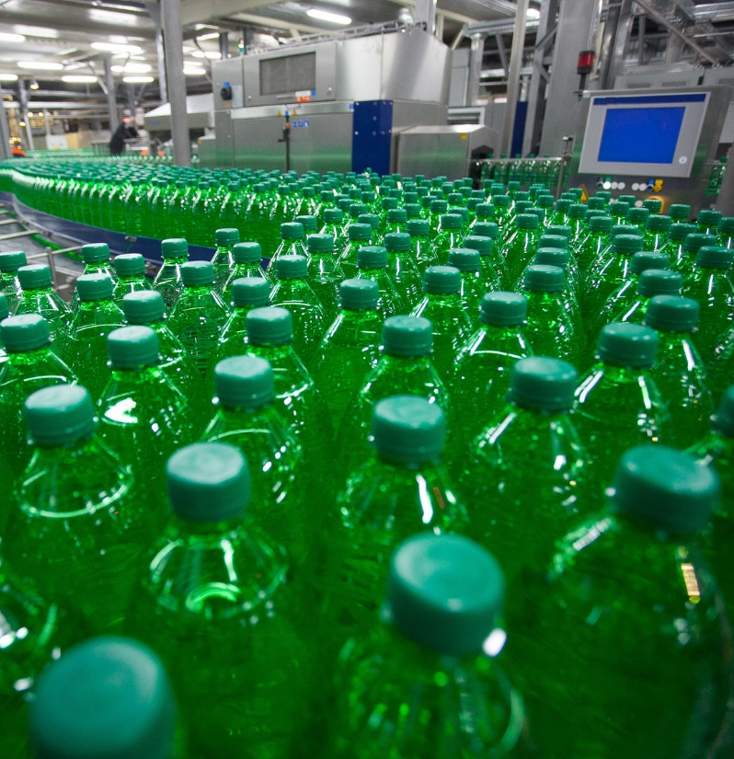
Extended producer responsibility
Aim: To make ‘polluters pay’
How it works: Producers made to pay full costs for products/packaging impacts, or, at a minimum for recycling or landfill costs
Notes:
Idea to target those with most control over impacts of products and packaging
Already proposed for packaging
Gov’t has consulted on new system for packaging, with more to come for electronics, vehicles, batteries and possibly other waste streams.

Slide 5
Producer responsibility: pros and cons
Pros:
Targets those with most control over impacts
Encourages good design
Cons:
Calculating full costs fairly is a challenge
Current approach limited to increasing recycling
Notes:
Idea to target those with most control over impacts of products and packaging
Already proposed for packaging
Gov’t has consulted on new system for packaging, with more to come for electronics, vehicles, batteries and possibly other waste streams.

Slide 6
Advertising bans
Aim: To discourage harmful or unnecessary purchases
How it works: Polluting products or sectors, like fast fashion, aren’t allowed to advertise. Could tie in to rules on children’s advertising
Notes:
We’re already targeting ads for tobacco, junk food, which harm human health – why not target ads that harm planetary health?
Effect of tobacco advertising ban questioned: https://www.jstor.org/stable/20460839?seq=1 (perhaps what really drove decrease was outright ban…)

Slide 7
Advertising bans: pros and cons
Pros:
Stops ‘manufactured needs’
Logical to ban ads for products that harm environment if we’re doing so for those that harm health
Cons:
Questions of effectiveness
Difficult to police online spaces
Notes:
We’re already targeting ads for tobacco, junk food, which harm human health – why not target ads that harm planetary health?
Effect of tobacco advertising ban questioned: https://www.jstor.org/stable/20460839?seq=1 (perhaps what really drove decrease was outright ban…)

Slide 8
Resource efficiency standards
Aim: To improve products’ design
How it works: Products can on be sold if they meet rules for how long they last, whether they can be repaired or reused, etc
Notes:
Ecodesign has led to design innovation. Saved average household more than £400 a year in energy costs. Some initial movement to increase repairability of some electronics (professional repairers). Could be expanded.
Tied in to the ‘right to repair’

Slide 9
Efficiency standards: pros and cons
Pros:
Already used to improve electronics’ energy use: encourages better design, lowers energy use and saves money
Could give people ‘right to repair’
Cons:
Complicated to set standards
Could require trade-offs
Notes:
Ecodesign has led to design innovation. Saved average household more than £400 a year in energy costs. Some initial movement to increase repairability of some electronics (professional repairers). Could be expanded.
Tied in to the ‘right to repair’

Slide 10
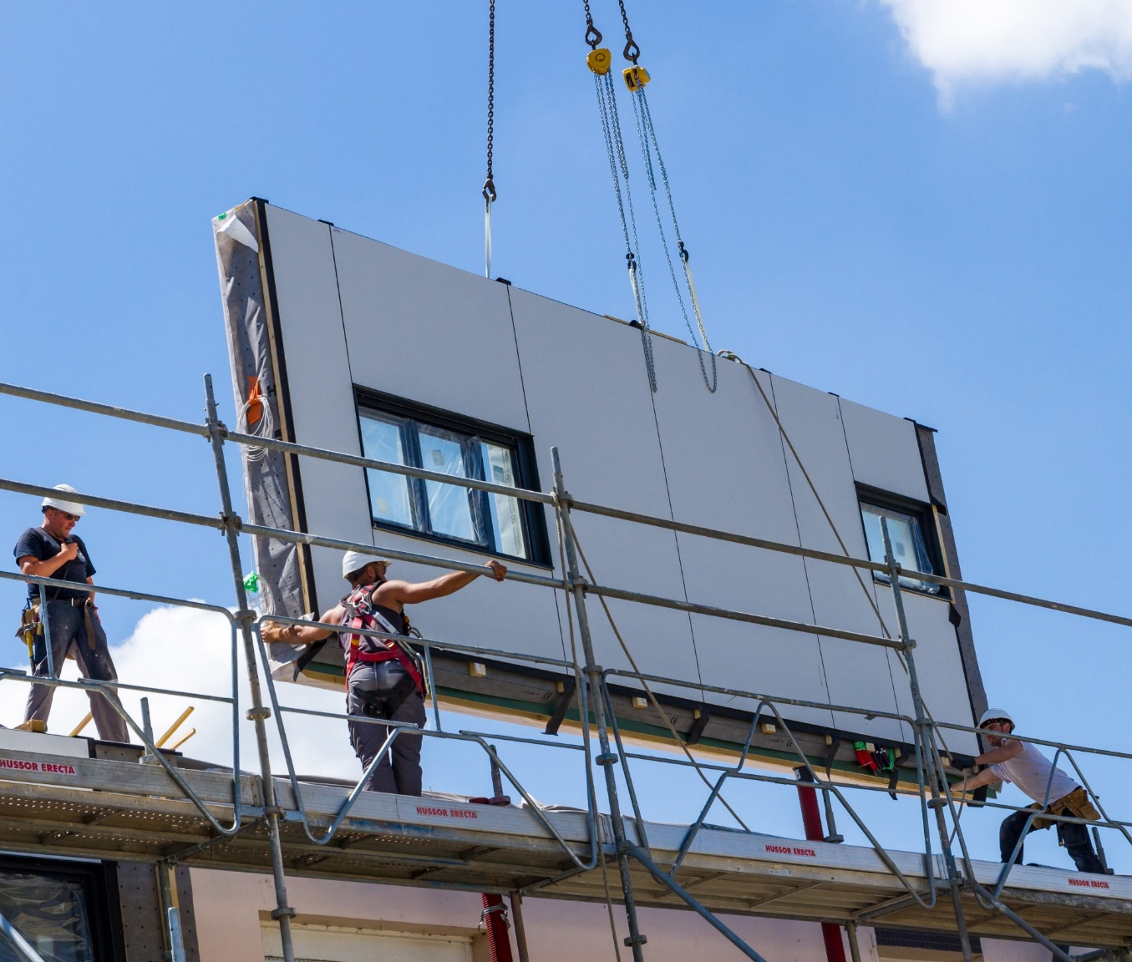
Targets for high impact sectors
Aim: To reduce the amount of material used and emissions created by industry
How it works: Manufacturing sectors are examined for where they can improve and given targets
Notes:
Doubling resource productivity by 2050 across the whole economy.
30 sectors (of 100+) account for 80% or UK’s material and carbon footprints. Sectors like construction, vehicles, textiles, electronics, food and drink offer considerable potential for improvement, but currently only have voluntary targets.
Collective responsibility could be problem if there are laggards and freeriders

Slide 11
Targets for sectors: pros and cons
Pros:
Specific sectors like construction, electronics, fashion made to reduce emissions and material use
Relatively ‘quick wins’
Cons
Challenge to identify those to hold to account
Notes:
Doubling resource productivity by 2050 across the whole economy.
30 sectors (of 100+) account for 80% or UK’s material and carbon footprints. Sectors like construction, vehicles, textiles, electronics, food and drink offer considerable potential for improvement, but currently only have voluntary targets.
Collective responsibility could be problem if there are laggards and freeriders

Slide 12
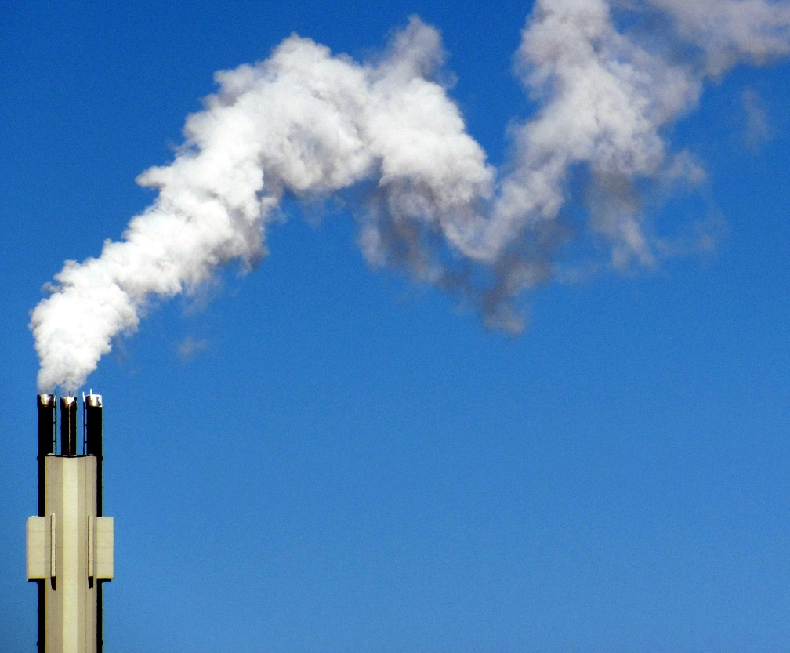
Taxes on producers
Aim: To lower producers’ impact
How it works: Producers charged or taxed for the impact from their emissions or material choices
Notes:
…new tax expected on non-recycled plastic, for instance. Only for packaging and only for those that don’t have 30% recycled content. Could be expanded to other material to reflect impact of using virgin materials/account for material impacts/increase reuse/use of recycled content.

Slide 13
Taxes on producers: pros and cons
Pros:
Has already improved energy use
Could discourage unnecessary material use, especially for ‘virgin’ (i.e. not recycled) materials
Cons:
Difficult to calculate and administer, especially for goods from abroad
Notes:
Already exists as carbon price floor, though future is uncertain
Complicated supply chains

Slide 14
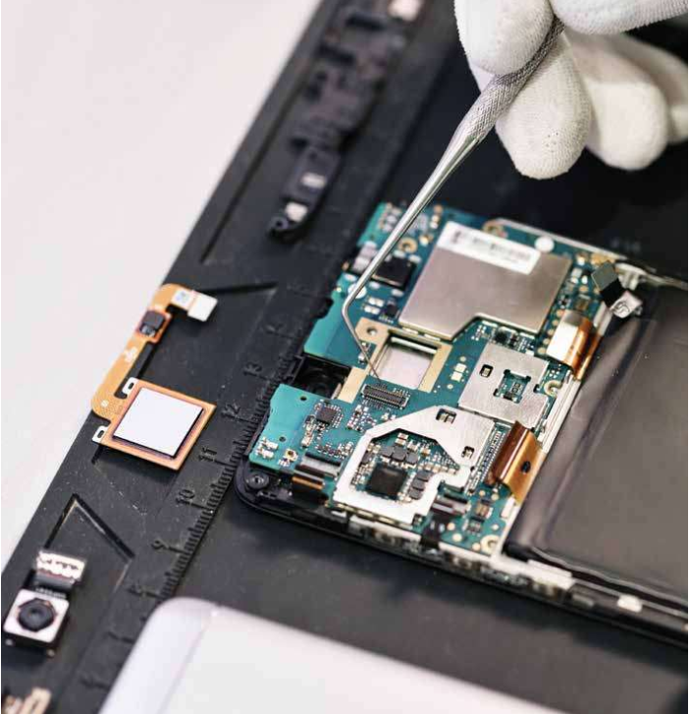
Taxes on products/services
Aim: To encourage people to buy greener goods and services
How it works: Green products or services have low/no tax; dirtier products or services have higher tax
Notes:
Services like repair, refurbishment, leasing, product service systems could have no VAT/tax
…already happens in Sweden with zero VAT on repair. Would redress current imbalance in sectors like construction where VAT is charged on refurbishment activity but not new builds

Slide 15
Taxes on products/services: pros and cons
Pros:
Makes green products more affordable
Could encourage reuse/repair/sharing
Cons:
Potentially unfair as wealthy could continue buying less green options
Notes:
Services like repair, refurbishment, leasing, product service systems could have no VAT/tax
…already happens in Sweden with zero VAT on repair. Would redress current imbalance in sectors like construction where VAT is charged on refurbishment activity but not new builds

Slide 16
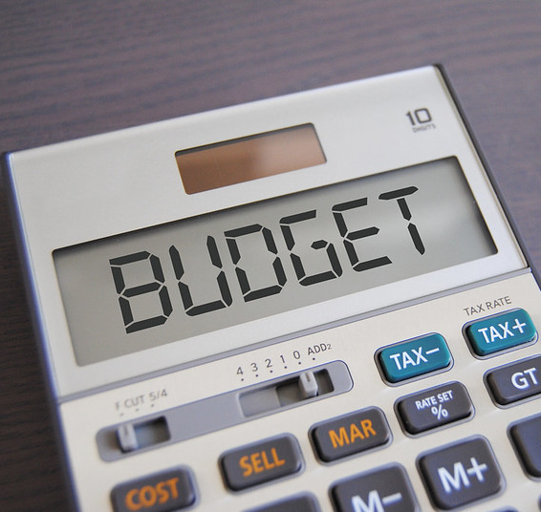
Personal allowances
Aim: To fairly distribute emissions from what we buy
How it works: Individuals get annual ‘budgets’ to ‘spend’ depending on the impact of their purchases. Potentially, credits could also be traded or owed, like money
Credit www.gotcredit.com
Notes:
Equitable: targets high consumers, who tend to be wealthier. Would allow people to identify what to prioritise: e.g. reduce food waste, meat consumption, gadget purchases
EU (ETS) for large corporations – viewed as a pro-choice, pro-business policy, allowing businesses to make savings as they see fit. A market mechanisms to promote low-carbon practices.
Applied at a personal level, the richest would need to change behaviour more than with the tax model, which would be more likely to see wealthy continue current patterns of consumption.

Slide 17
Personal allowances: pros and cons
Pros:
A fair way to drive change
Makes people more aware of the impacts of their choices
Cons:
Fears over ‘rationing’
Complex to administer
Notes:
Equitable: targets high consumers, who tend to be wealthier. Would allow people to identify what to prioritise: e.g. reduce food waste, meat consumption, gadget purchases
EU (ETS) for large corporations – viewed as a pro-choice, pro-business policy, allowing businesses to make savings as they see fit. A market mechanisms to promote low-carbon practices.
Applied at a personal level, the richest would need to change behaviour more than with the tax model, which would be more likely to see wealthy continue current patterns of consumption.

Slide 18
Thank you
Libby Peake, Head of resource policy
lpeake@green-alliance.org.uk

