Slide 1
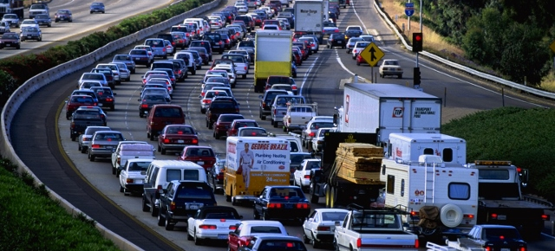
Alternatives to Cars for Surface Transport

Slide 2



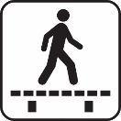
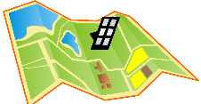
Alternatives to cars
How could we make buses, trams and trains much more attractive?
Could more cycling and walking lead to less car use?
How does the planning system affect how we travel?
Notes:
Map icon: Ilya Sedykh, Shmector.com.

Slide 3
How could we make buses, trams and trains much more attractive?
Some real world examples…
Munich, Zurich, Dunkirk

Slide 4
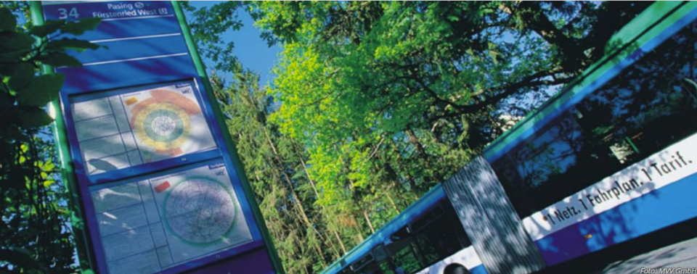
Munich region: buses, trams, trains co-ordinated
“One Network, One Timetable, One Ticket”
Notes:
In Munich city region, buses, trams, and local trains are coordinated by a public transport governing body known as a Verkehrsverbund.
Buses, trams and trains all connect with each other. There is a comprehensive service, covering all the different places that people may want to travel to.
The motto of the Munich city-region Verkehrsverbund is “one network, one timetable, one ticket”.

Slide 5
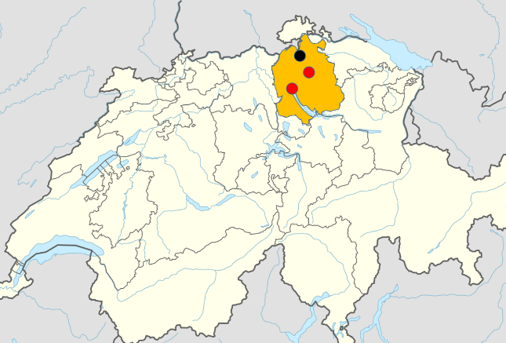
Berg am Irchel
Zurich
city-region
Public transport service standards, enshrined in law
Winterthur
Zurich
SWITZERLAND
Notes:
In the region around the city of Zurich in Switzerland, there is also a Verkehrsverbund.
But in addition, Zurich city region has public transport service standards, which are enshrined in law, to enable convenient travel between any two places bigger than a small village.

Slide 6
Zurich region service standards
Settlements >300 people – every hour
Corridors where multiple settlements give strong demand – every 30 minutes
Large dense settlements – every 15 minutes
Services run 6am to midnight
Seven days a week
Buses and trains connect
Services repeat hourly at regular intervals
Notes:
Zurich region public transport service standards state that….
Source: Regulation 740.3 Verordnung über das Angebot im öffentlichen Personenverkehr (Angebotsverordnung) 1988 https://www.zh.ch/internet/de/rechtliche_grundlagen/gesetze/erlass.html?Open&Ordnr=740.3

Slide 7
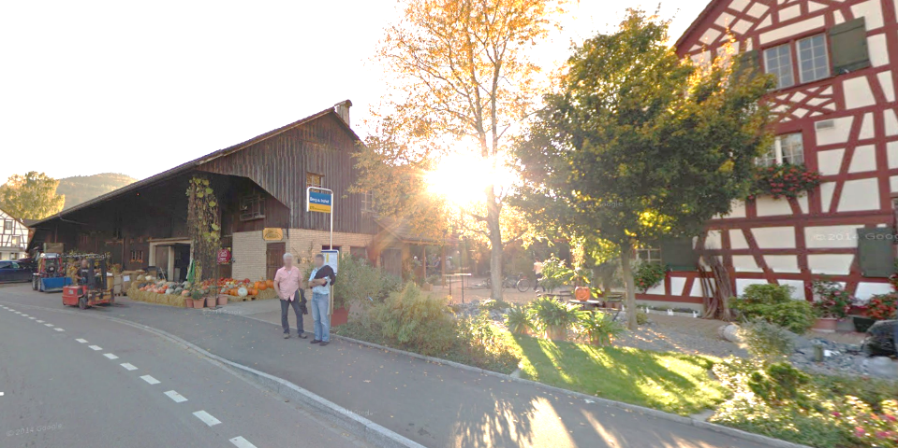
Berg am Irchel: population 564
© Google
Notes:
So if you look at the public transport for the small village of Berg am Irchel (with a population of 564)…

Slide 8
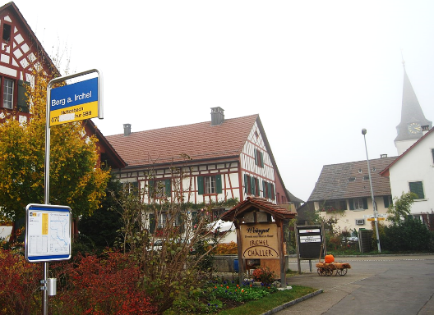
First direct bus to Winterthur at 5.30am.
From 5.48am to 9.48pm:
bus at 11 and 48 minutes past hour, to Hettlingen / Andelfingen
…connecting to train (~3 minute connection) to Winterthur
Last bus to Winterthur at 11.38pm.
Image: Dietrich Michael Weidmann
Notes:
The first bus to Winterthur leaves at 5.30 in the morning.
From 5.48am till 9.48pm, there is a bus at 11 and 48 minutes past each hour, either to Hettlingen or to Andelfingen on the train line to Winterthur.
…And that connects with a train to Winterthur with a 3 minute connection.
The last bus to Winterthur departs at 11.38pm.

Slide 9
Public transport trips per person per year
European city regions
English city regions
Notes:
This graph shows public transport trips per person in six European city-regions (in green), and in nine English city-regions (in red).
The average resident of Munich city-region makes about 250 public transport trips per year, and the average resident of Zurich city-region makes about 450 public transport trips. In contrast, the average resident of the West Midlands makes about 100 public transport trips per year.
The higher public transport use in the six European city-regions is despite the fact that they have quite low population densities, because they extend further out to rural areas than our English city-regions.
Source: Sloman and Hopkinson (2019) Transforming public transport http://www.transportforqualityoflife.com/policyresearch/transportandclimatechange/

Slide 10
If 9 English city-regions had same level of public transport use as the European city-regions:
9%
Car mileage
© Flikr Creative Commons
Notes:
If our 9 English city-regions had levels of public transport use that matched the average for the six European city-regions on the graph (about 280 public transport trips per person per year), the effect on car mileage in English city regions (the nine English combined authorities) would be to reduce it by about 9%.
Source: Sloman and Hopkinson (2019) Transforming public transport http://www.transportforqualityoflife.com/policyresearch/transportandclimatechange/

Slide 11
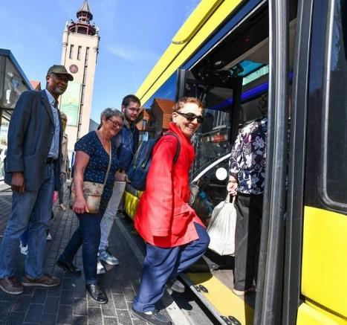
New approach in Dunkirk, France
Since September 2018:
all buses free
network improved
Effect in one year:
bus trips +85%
half of new bus users previously drove
1 in 10 new bus users sold their second car
Dunkerque
Notes:
Some local authorities in France are starting to look at new options to encourage people to switch from car to bus.
Dunkirk made its buses free in autumn 2018 and at the same time transformed its bus network.
One year on, bus trips are up 85%, half of new bus users previously drove, one in ten new bus users have sold their second car.
Source: Huré M., Javary C-M. and Vincent J (2019) Le nouveau réseau de transport gratuit à Dunkerque Observatoire des Villes du Transport Gratuit

Slide 12
Could more cycling and walking lead to less car use?
Some more real world examples…
Seville, London, Denmark

Slide 13
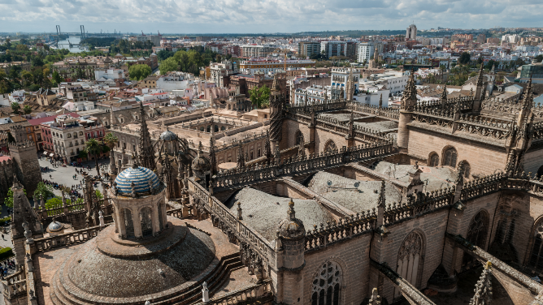
Seville
© Wikimedia Commons
4th largest city in Spain (700,000 population)
Big roads…but also big traffic congestion
‘Too hot’ to be natural cycling territory
© Wikimedia Commons
Notes:
Seville:
fourth largest city in Spain, population of 700,000.
by 1990s, with a growing economy, there had been huge increases in car ownership
despite some big roads, with a lot of space dedicated to cars, traffic congestion had become a major issue.
growing pressure for something to be done.
Cycling wasn’t seen as the natural solution to this. The city didn’t have a cycling culture.
And it is right in the south of the country; very high summer temperatures, so many people saw it as too hot a city for cycling to be attractive.

Slide 14
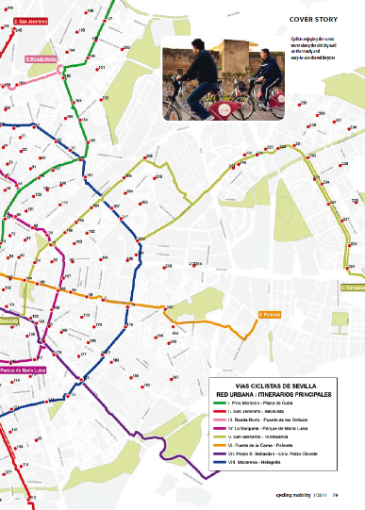
Segregated cycle paths
120km
(2007 to 2011)
Notes:
But between 2007 and 2011, Seville built 120km of segregated cycle paths, alongside main roads but physically separated from traffic.

Slide 15
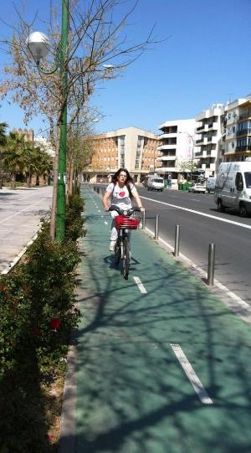
Seville: increase in cycle trips per day
73,000
13,000
Notes:
This resulted in a massive increase in cycling – from 13,000 cycle trips on a typical weekday in November in 2006 to 73,000 five years after the bike lanes were built.
It is particularly noticeable when you visit Seville that there are lots of older people, and children, and women, on bikes – it isn’t just young fit men.
Source: Marques et al. (2015) How infrastructure can promote cycling in cities: lessons from Seville Research in Transportation Economics 53, pp31-44

Slide 16
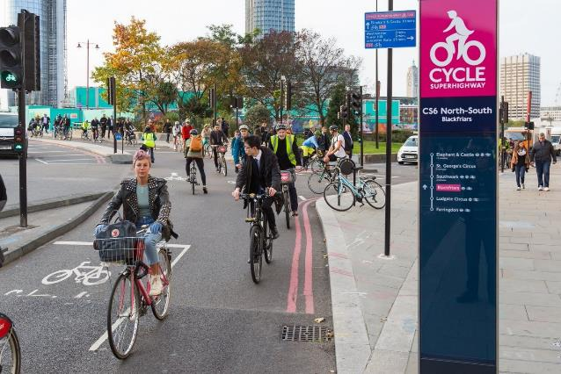
London: high quality cycleways encourage more cycling
London car driver mileage that is “potentially cyclable”: 27%
Notes:
London is also building high quality cycleways that are physically separated from cars, so that they feel very safe. On routes like this one across the River Thames in central London, in the rush hour, there are now more people travelling by bike than the number of people travelling by car and bus put together.
Our analysis of TfL research suggests about a quarter (27%) of car driver mileage by London residents is potentially cyclable.
Source: adapted from Transport for London (2017) Analysis of Cycling Potential. The TfL Analysis of Cycling Potential draws on data from the London Travel Demand Survey for the period 2012/13 – 2014/15. Sloman and Hopkinson (2019) Segregated cycleways and e-bikes (http://www.transportforqualityoflife.com/u/files/4%20Segregated%20cycleways%20and%20e-bikes%20briefing.pdf) used the same dataset to estimate total daily car driver distance by London residents, and then estimated the distance travelled as part of ‘potentially cyclable’ car driver trips using trip distance data from Figure 3.7 of TfL (2017) Analysis of Cycling Potential.

Slide 17
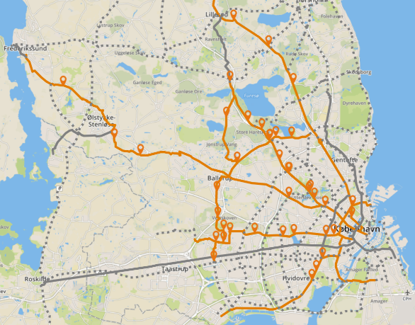
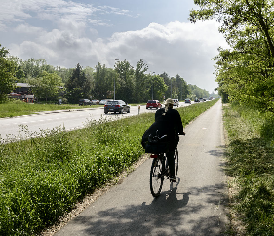
Cycling can also replace cars outside cities
Cycle Superhighways around Copenhagen
Notes:
Cycling also has the potential to replace car travel outside big cities.
Denmark is building long-distance cycle superhighways that radiate from towns.
This map shows the cycle superhighway programme around Copenhagen. When finished, there will be nearly 750km of long distance Cycle Superhighways radiating up to 40km.
On the routes completed so far, 25% of users previously drove and the average bike commute distance is 15km.
Source: Office for Cycle Superhighways (2018) Cycle Superhighways in the Capital Region of Denmark https://supercykelstier.dk/wp-content/uploads/2016/03/H%C3%A6fte-UK-2018.pdf

Slide 18
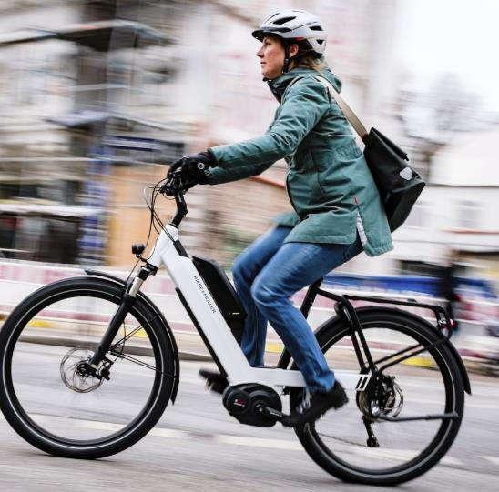
40-60% of electric bike trips replace car trips
Notes:
One reason why these Danish cycle superhighways are proving so successful is the growing use of electric bikes.
Studies in the UK and Europe typically find that around half (40-60%) of electric bike trips replace trips that would otherwise be made by car.
They are used for longer journeys than conventional bikes, and have broader appeal, including to women, older people and people who are less active.
Source: Newson and Sloman (2019) The case for a UK incentive for e-bikes https://www.bicycleassociation.org.uk/wp-content/uploads/2019/07/The-Case-for-a-UK-Incentive-for-E-bikes-FINAL.pdf

Slide 19
E-bike sales are high in Europe
Annual sales of e-bikes per 1000 people
Notes:
E-bike sales are high in Europe.
In Belgium and the Netherlands, annual sales are running more than 20 times the level per 1000 people that they are in Britain.
A main reason for this is that local or national governments have offered grants to incentivise purchase of e-bikes.
Source: Newson and Sloman (2019) The case for a UK incentive for e-bikes https://www.bicycleassociation.org.uk/wp-content/uploads/2019/07/The-Case-for-a-UK-Incentive-for-E-bikes-FINAL.pdf

Slide 20
How does the planning system affect how we travel?

Slide 21
Factors affecting how much people drive
Location: big city OR town OR rural
Density: homes close together (>100 homes per hectare) OR homes spread out (<25 homes per hectare)
Local facilities: lots of local shops and services OR no shops within walking distance
Connectivity: good rail / tram / bus services nearby OR poor public transport

Slide 22
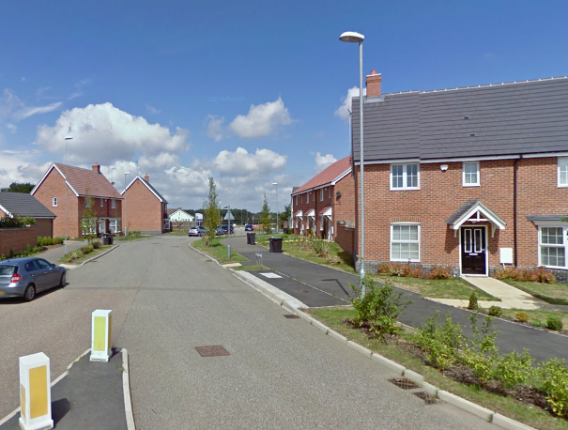
Car-dependent housing in rural areas
Priors Green, Essex
81%
residents drive to work
©2016 Google
Notes:
This is new housing development in the countryside in Essex. It’s about five miles from the nearest small market town, Great Dunmow. It has few local facilities and poor public transport.
More than eight out of ten of residents in employment travel to work by car.
Source: analysis of travel to work mode share data from 2011 Census

Slide 23
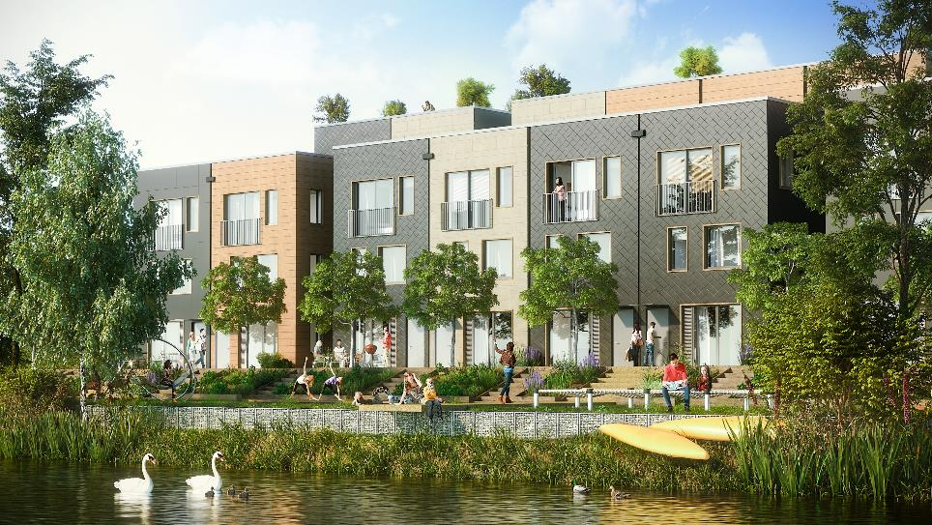
Climate Innovation District, Leeds
>100 homes per hectare
© CITU
Notes:
This is a planned new development in Leeds city centre, designed for high levels of walking and cycling. It will have more than 100 homes per hectare, but there is still plenty of green space and it isn’t high rise.
People living in houses like these will have 2-3 times lower car mileage than people living in car-dependent housing in a rural location.
Source: Hopkinson and Sloman (2019) Planning for less car use http://www.transportforqualityoflife.com/u/files/3%20Planning%20for%20less%20car%20use%20briefing.pdf

Slide 24
Summary: Alternatives to cars
Coordinated public transport with frequent services can cut car use
Cycle tracks and electric bikes can cut car use too
Building homes in cities, to higher densities, with local facilities and good public transport will generate less car use too
Notes:
Map icon: Ilya Sedykh, Shmector.com.

