Slide 1
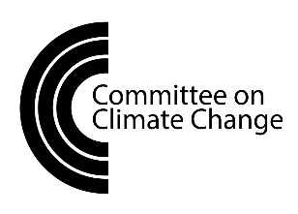
Technical options for reducing
emissions from air travel
Owen Bellamy
Committee on Climate Change

Slide 2
Hard to reduce emissions from air travel
No obvious technical options for zero emissions
Uses a lot of energy and has strict safety standards
Long life-time of planes (20-30 years) and long development times
Few companies operating in global market

Slide 3
Technology has improved significantly since the 1950s
Since the start of the jet age aircraft fuel efficiency has improved by around 75%
Through advances in engine and aircraft designs
But limits to existing technologies
Demand has grown faster than fuel efficiency has improved, so emissions have increased

Slide 4
Options to reduce emissions
Improve fuel efficiency with new technologies
Engines
Aircraft design
Switch to low-carbon fuels

Slide 5
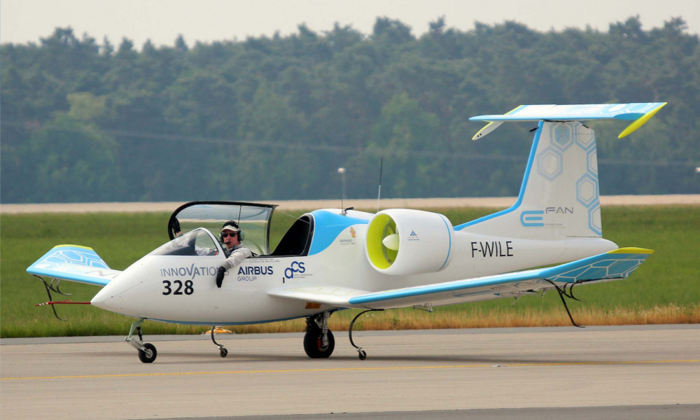
New engine designs
Next generation of jet engine could offer ~30% fuel saving (from 2030s)
Electric planes are being developed and could mean zero-emission flying
But only for short flights and unlikely to be significant before 2050
Airbus E-Fan X

Slide 6
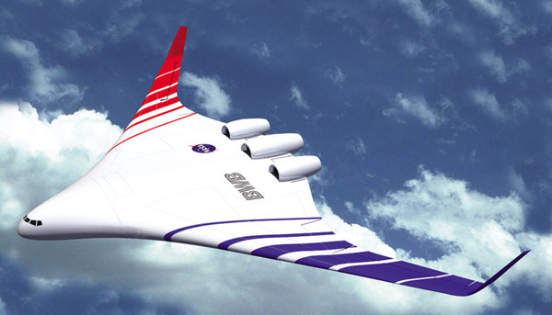
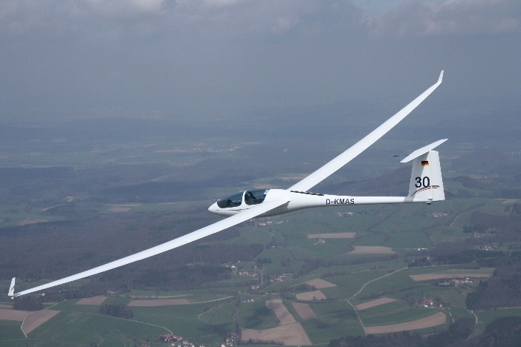
New aircraft designs
New materials (~10% fuel saving, already starting to be used)
New wing designs (up to ~30% fuel saving but airport design challenges)
Re-design for lower speeds (~20% fuel saving but implications for scheduling)

Slide 7
Alternative fuels
Biofuels
Currently safety certified up to 50% use, but less than 0.1% of total aviation fuel consumption
Limited global supply and potential for larger emission savings in other sectors, so do not plan for high levels (e.g. 10%)
Synthetic fuels
Possible to make carbon-neutral fuels by combining hydrogen and carbon, but likely to be very expensive

Slide 8
Costs
Technologies
Biofuels
Synthetic fuels
No extra cost or could save money
Costs more than fossil fuels
Likely to be very expensive

