Slide 1
Alternatives to air travel
Professor Alice Larkin
Head of School of Engineering & Researcher in the
Tyndall Centre for Climate Change
University of Manchester

Slide 2
Alternatives to air travel UK Residents
Within UK– rail, road, ferry, virtual (e.g. teleconferencing)
Within EU – high-speed rail, rail, road, ferry, virtual, alternative destination
Outside EU – virtual, high-speed rail, rail, ship, alternative destination
Notes:
Virtual – ie teleconferencing or video conferencing

Slide 3
Sea travel: UK passengers in 2018
Domestic: 43 million - decreasing trend
River ferries (21M), inter-island (19M) & domestic sea (3.5M)
International: 22 million– cruise increasing
Short-sea (20M), cruise (2.2M)
Channel tunnel more popular than ferry (just!)
Notes:
Data: https://assets.publishing.service.gov.uk/government/uploads/system/uploads/attachment_data/file/844835/sea-passenger-statistics-all-routes-2018-final.pdf - DfT Sea Passenger Statistics: All routes 2018
Around twice as many domestic passengers as international

Slide 4
Decarbonising ships
Wide range of potential options for cutting CO₂
Many ships to last 30-40 years – easier to retrofit than planes
Relationship between ship speed & fuel required means slowing ships down can cut CO₂
Slowing down PLUS using other technologies = bigger CO₂ cuts
Voyage length matters – shorter voyages = battery power now!
Notes:
References to own work:
Bows-Larkin, 2014: https://www.tandfonline.com/doi/abs/10.1080/14693062.2014.965125
Gilbert et al., 2015: https://www.tandfonline.com/doi/full/10.1080/17583004.2015.1013676
Bows-Larkin et al., 2014: https://www.research.manchester.ac.uk/portal/files/40102807/High_Seas_High_Stakes_High_Seas_Project_Final_Report.pdf
PhD study, Bullock et al., ongoing and paper submitted: Bullock, S., Mason, J., Broderick J., and Larkin, A., Shipping and the Paris Climate Agreement: a focus on committed emissions, BMC Energy, in review. – this notes that lifetime of EU ships is higher than rest of the world – 30 years – so reinforces point about retrofit.

Slide 5
Decarbonising ships
Option | New/retrofit | Opportunity/barrier
Slow steaming | Either | Immediate / timing matters
Weather routing | Either | Immediate / scheduling
Electric or hybrid | New | Immediate / needs investment
Natural gas | New | Not low CO₂ / new infrastructure
Ammonia fuel | New | >10 years for significant uptake
Hydrogen | New | 2030 / upstream CO₂?
Biofuel | Either | Immediate/sustainability concerns
Wind-assist | Either | Soon /needs investment as risky
Notes:
References to own work:
Bows-Larkin, 2014: https://www.tandfonline.com/doi/abs/10.1080/14693062.2014.965125
Gilbert et al., 2015: https://www.tandfonline.com/doi/full/10.1080/17583004.2015.1013676
Bows-Larkin et al., 2014: https://www.research.manchester.ac.uk/portal/files/40102807/High_Seas_High_Stakes_High_Seas_Project_Final_Report.pdf
Traut et al., 2014: https://www.sciencedirect.com/science/article/pii/S0306261913005928
Gilbert et al., 2018: https://doi.org/10.1016/j.jclepro.2017.10.165
Also avialability concerns for biofuels cf aviation
Technology to cut CO₂ varies by ship market
Short-sea and rivers – battery electric/hybrid
High seas and cruise – all other options
Ammonia: https://www.google.com/url?sa=t&rct=j&q=&esrc=s&source=web&cd=1&ved=2ahUKEwjdq_-expznAhUwQEEAHVhGBqIQFjAAegQIBhAB&url=https%3A%2F%2Feurope.edf.org%2Ffile%2F399%2Fdownload%3Ftoken%3DagUEbKeQ&usg=AOvVaw091FngawDyqXyeiQeWSqXj
The Viking Grace is a sail-assisted cruise ferry working in the Baltic sea
356 hybrid or all electric under construction

Slide 6
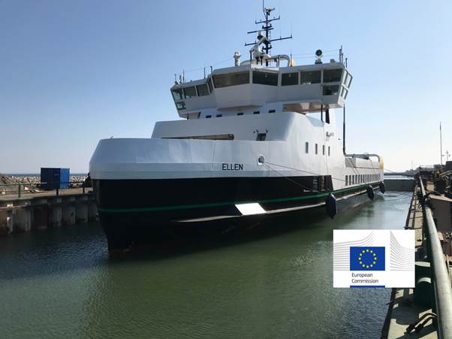
Example:
Largest electric ferry August 2019
(http://e-ferryproject.eu)
200 passengers, 31 cars, 5 trucks
4.3 Mega Watt hour battery
One charge: 25 miles - highest in world
Notes:
7000 passenger ships in the world - Equasis Statistics using HIS Markit Maritime & Trade data. Total ships is 89k but this includes 18k tugs
Electric ships: 356 all-electric or hybrid ships in operation or under construction (DNV GL, 2019)
Only possible for short sea shipping due to the capacity limits of the batteries
Data from: (http://e-ferryproject.eu)
World’s largest all-electric ferry – ‘E-Ferry Ellen’
Operating – connects island with mainland Denmark
31 cars, 5 trucks 200 passengers
4.3 MWh battery
22nm distance on one charge – 13-13.5 knots

Slide 7
Port infrastructure
Energy needed in ports relies on ship fuel
Electrifying ports so ships plug in better for CO₂
CO₂ intensity of electricity at ports depends on national grid
Notes:
PhD study, Bullock et al., ongoing and paper submitted: Bullock, S., Mason, J., Broderick J., and Larkin, A., Shipping and the Paris Climate Agreement: a focus on committed emissions, BMC Energy, in review.

Slide 8
Rail travel: UK passenger in 2018
Domestic: 1.8 billion domestic - increasing trend
International: 22 million – increasing trend
Notes:
https://assets.publishing.service.gov.uk/government/uploads/system/uploads/attachment_data/file/851082/rail-factsheet-2019.pdf
International is eurostar + shuttle
https://www.statista.com/statistics/304968/number-of-passengers-travelling-on-the-eurostar-and-le-shuttle-in-the-united-kingdom/

Slide 9
Current UK trains
UK trains are electric or diesel
42% of current network is electrified
Carbon intensity per passenger kilometre…
Rail: 37 Eurostar: 6 [measured in grammes CO₂/passenger km]
electric train CO₂ depends on grid mix & engine efficiency
diesel train CO₂ depends on fuel & engine efficiency
Notes:
Phase out of diesel by 2040 gov announcement - https://www.railway-technology.com/features/goodbye-diesel-phase-mean-uk-rail-innovation/
https://assets.publishing.service.gov.uk/government/uploads/system/uploads/attachment_data/file/829336/2019_Green DEFRA methodology for stats, apart from for cars, where that doc is used and then passenger numbers applied (DEFRA 2019)

Slide 10
Reducing emissions from trains
Option | Opportunity/barrier
More electric | 42% of rails electrified; grid CO₂ intensity
Hybrid ‘bi-mode’ | Switch between diesel/elec; higher CO₂
Hydrogen Fuel cell | Many technical challenges
Will HS2 help reduce emissions? Depends…
- Better access to European rail & substitutes for air - yes
- Just more rail, more travel – not necessarily
Notes:
Complex issue HS2. Eurostar – high speed rail. Generate more travel.
The Viking Grace is a sail-assisted cruise ferry working in the Baltic sea
356 hybrid or all electric under construction
Bi-mode diesel higher co2 intessith than normal diesle and less eficieny

Slide 11
Alternative technologies
Option | Opportunity/barrier
Video/audio conferencing | Less appealing for leisure travel
Avatar conferencing | Requires investment & training
Augmented reality | Requires more research in AI
Isn’t the internet “high carbon”? Depends…
- Virtual travel changes what we do – more travel
- Enables people to live further from where they work
- Internet to have lower CO₂ as grid depends less on fossil fuel
Notes:
Avatar conferencing (virtual reality, VR, using 3-D camera and motion trackers) → simulates face-to-face meeting and allows sociability (Junuzovic et al., 2012)
Augmented reality, AR, adds extra degree of freedom to VR with enhanced realism (Yoon et al., 2019) through advanced technology and could be a ‘game changer’ in 5G network
Virtual conferencing uses ~7% energy/carbon as compared to in-person meeting (Ong et al., 2014), although it is case dependent.

