Slide 1

Rachael Everard
Head of Sustainability, Rolls-Royce plc
© 2018 Rolls-Royce plc
The information in this document is the property of Rolls-Royce plc and may not be copied or communicated to a third party, or used for any purpose other than that for which it is supplied without the express written consent of Rolls-Royce plc.
This information is given in good faith based upon the latest information available to Rolls-Royce plc, no warranty or representation is given concerning such information, which must not be taken as establishing any contractual or other commitment binding upon Rolls-Royce plc or any of its subsidiary or associated companies.
TotalCare®, SelectCare®, Life®, Term®, Flex®, Trent® and UltraFan® are registered trade marks of Rolls-Royce plc.
Private | Not subject to Export Control | © 2018 Rolls-Royce plc
© 2020 Rolls-Royce plc
The information in this document is the property of Rolls-Royce plc and may not be copied or communicated to a third party, or used for any purpose other than that for which it is supplied without the express written consent of Rolls-Royce plc.
This information is given in good faith based upon the latest information available to Rolls-Royce plc, no warranty or representation is given concerning such information, which must not be taken as establishing any contractual or other commitment binding upon
Rolls-Royce plc or any of its subsidiary or associated companies.
TotalCare®, SelectCare®, CorporateCare®, Trent®, Pearl® and UltraFan® are registered trade marks of Rolls-Royce plc

Slide 2
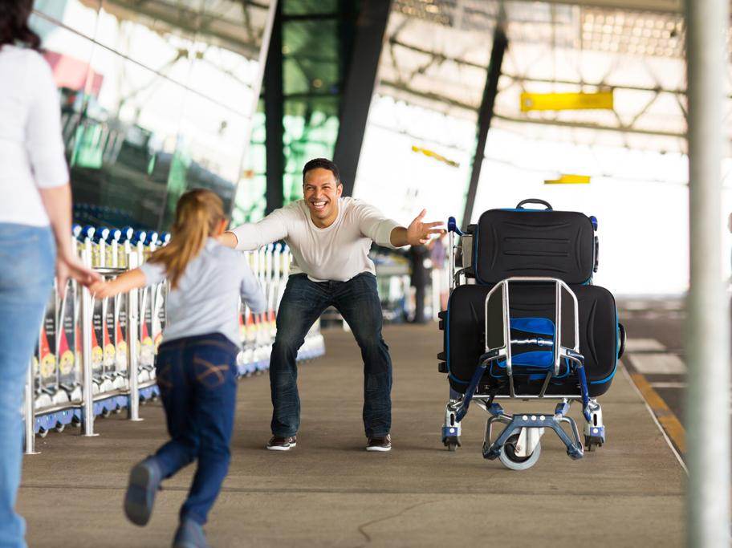
Flying is able to connect the world in a way no other transport or technology can.

Slide 3
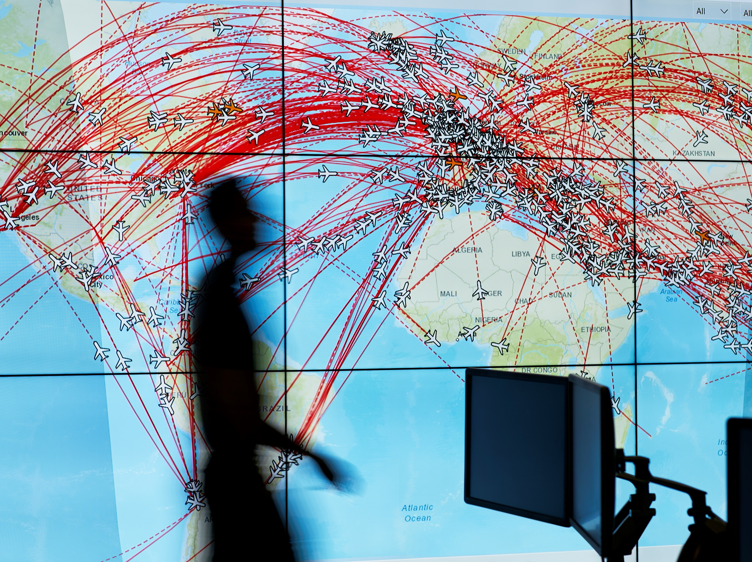
Flying has changed the way we understand the world and made it smaller than ever.

Slide 4
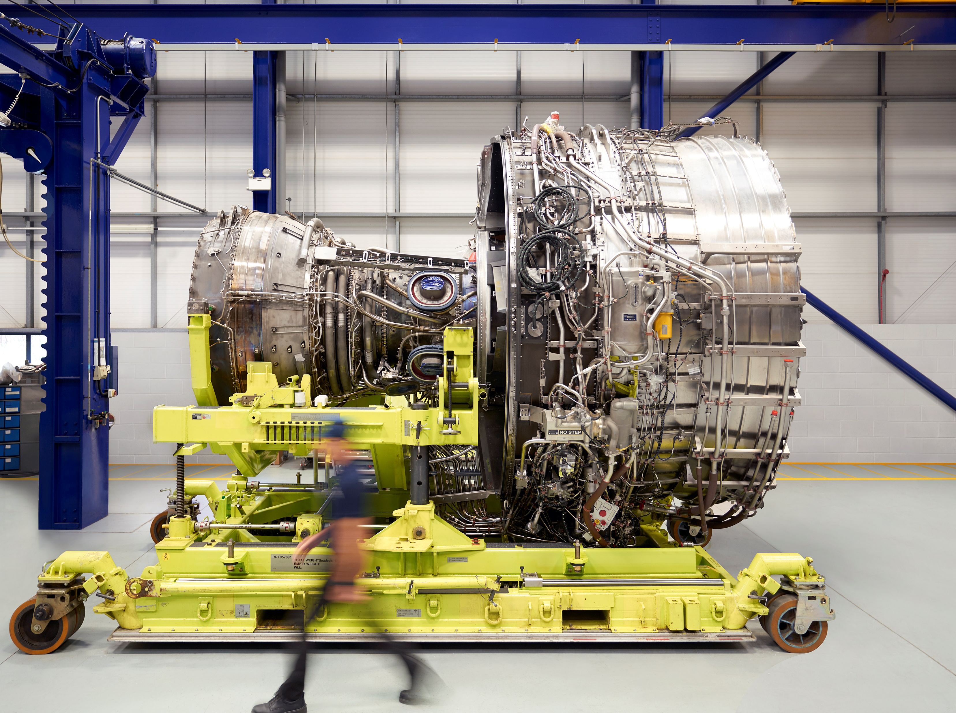
The world’s most efficient aero engine flying today – the Rolls-Royce Trent XWB.

Slide 5
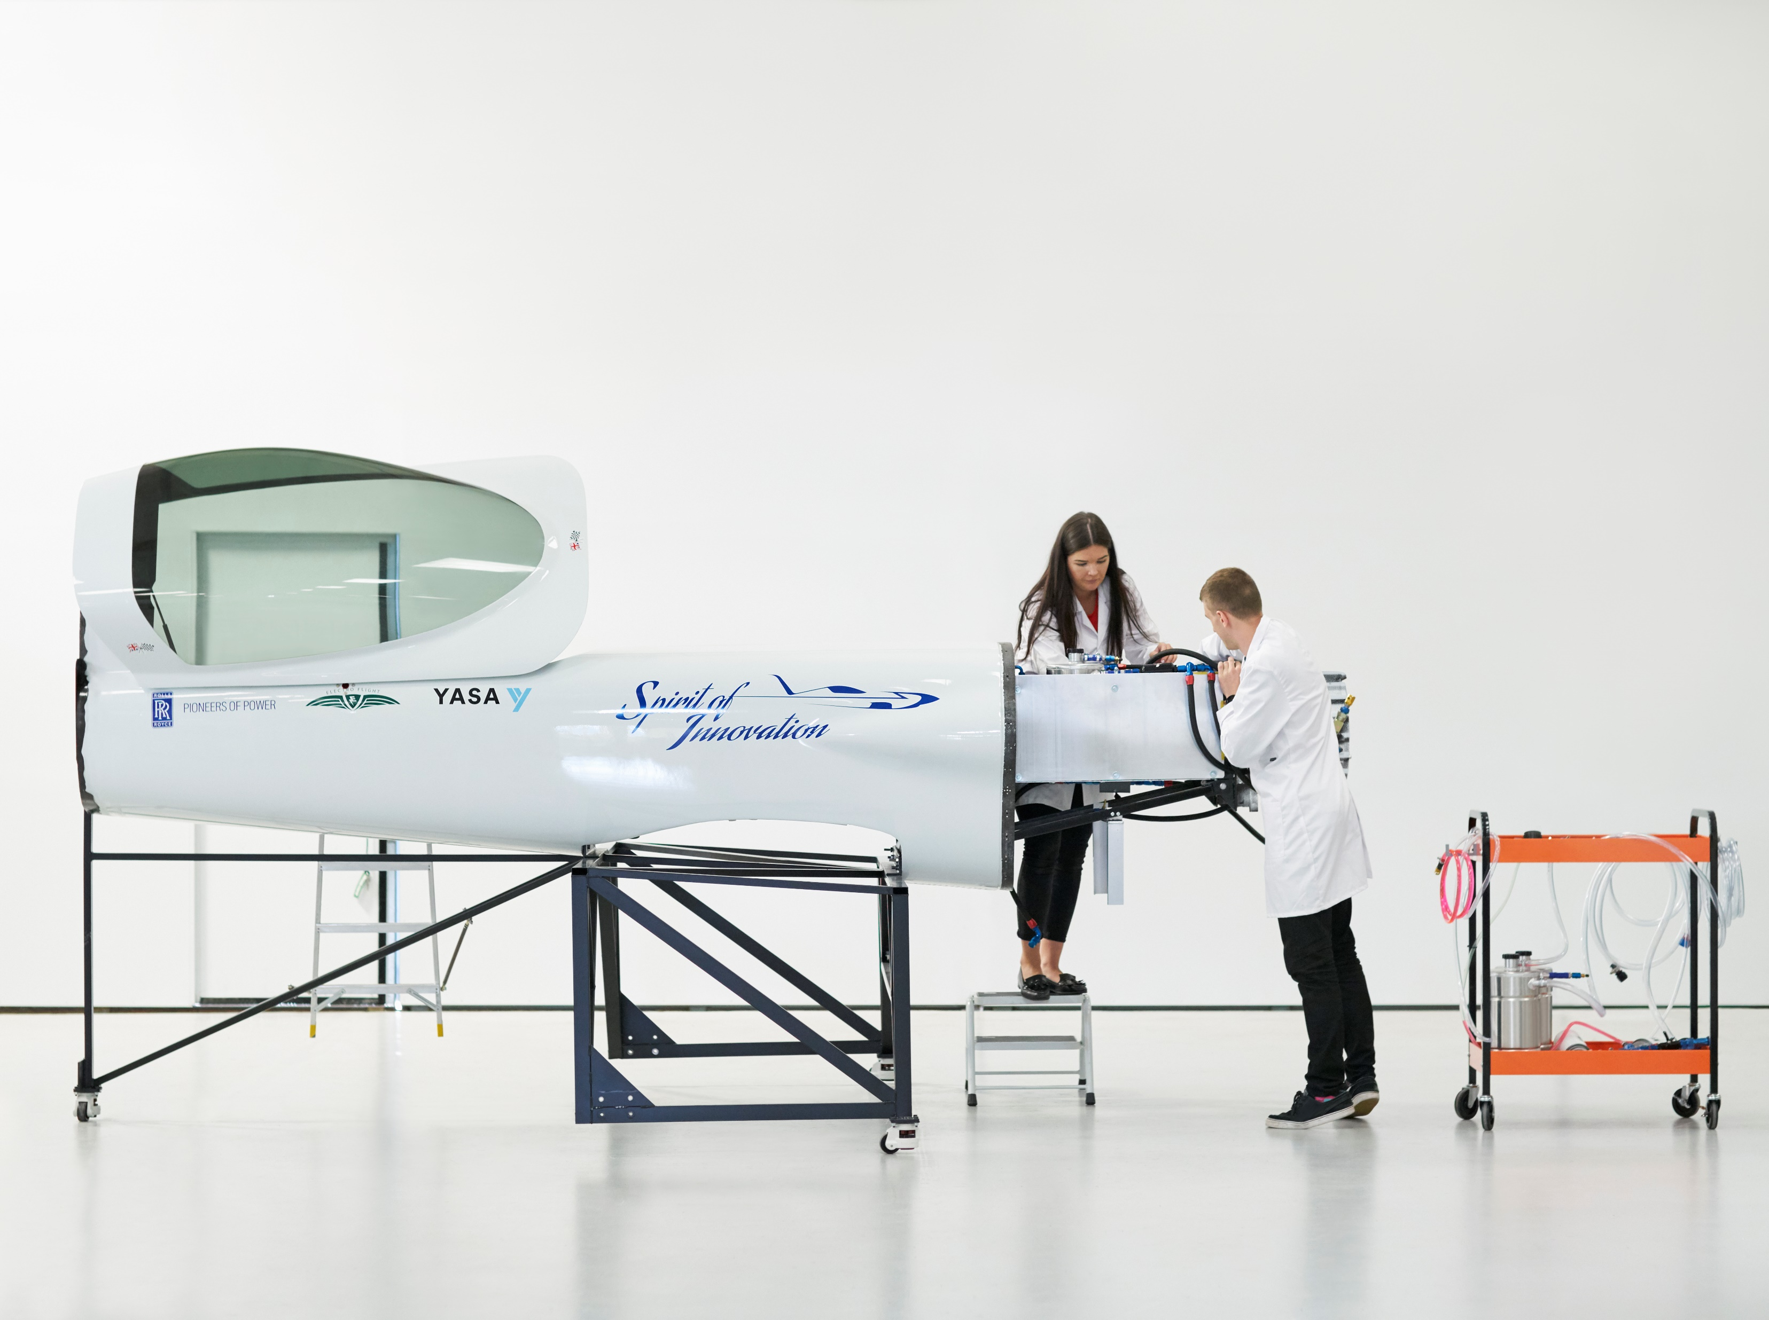
ACCEL – our fully electric, zero emission, aircraft will attempt to break the world speed record this year.

Slide 6
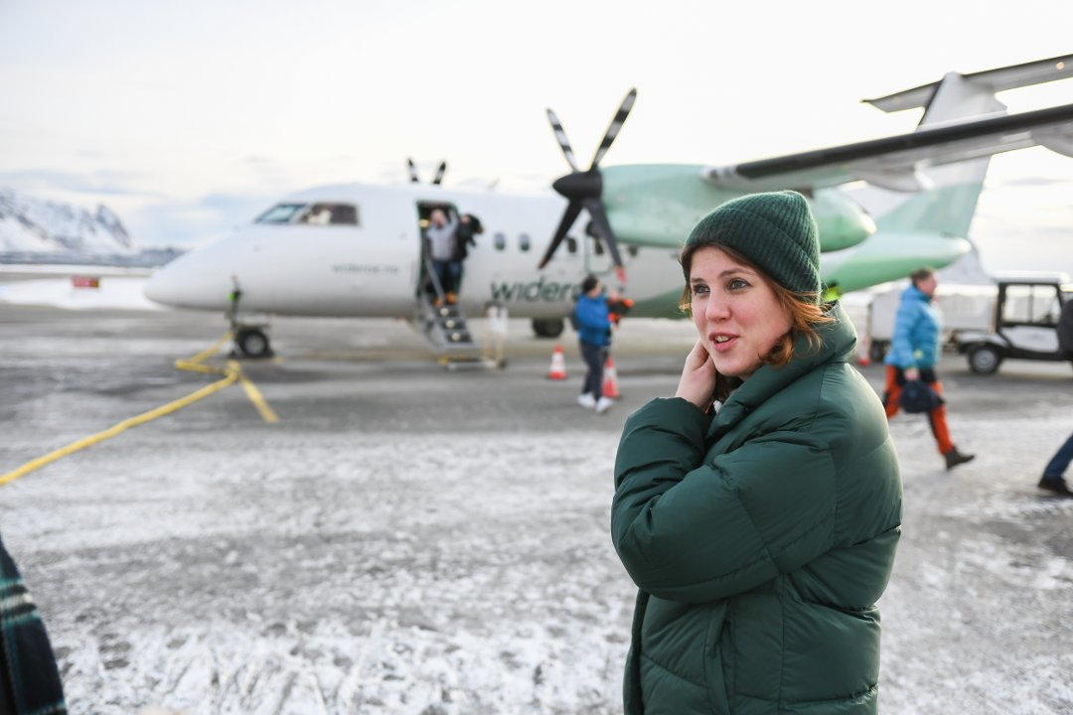
In the UK and Scandinavia we’re working with partners on hybrid-electric short hopping aircraft.
Image © Øystein Ingebrigtsen 2020

Slide 7
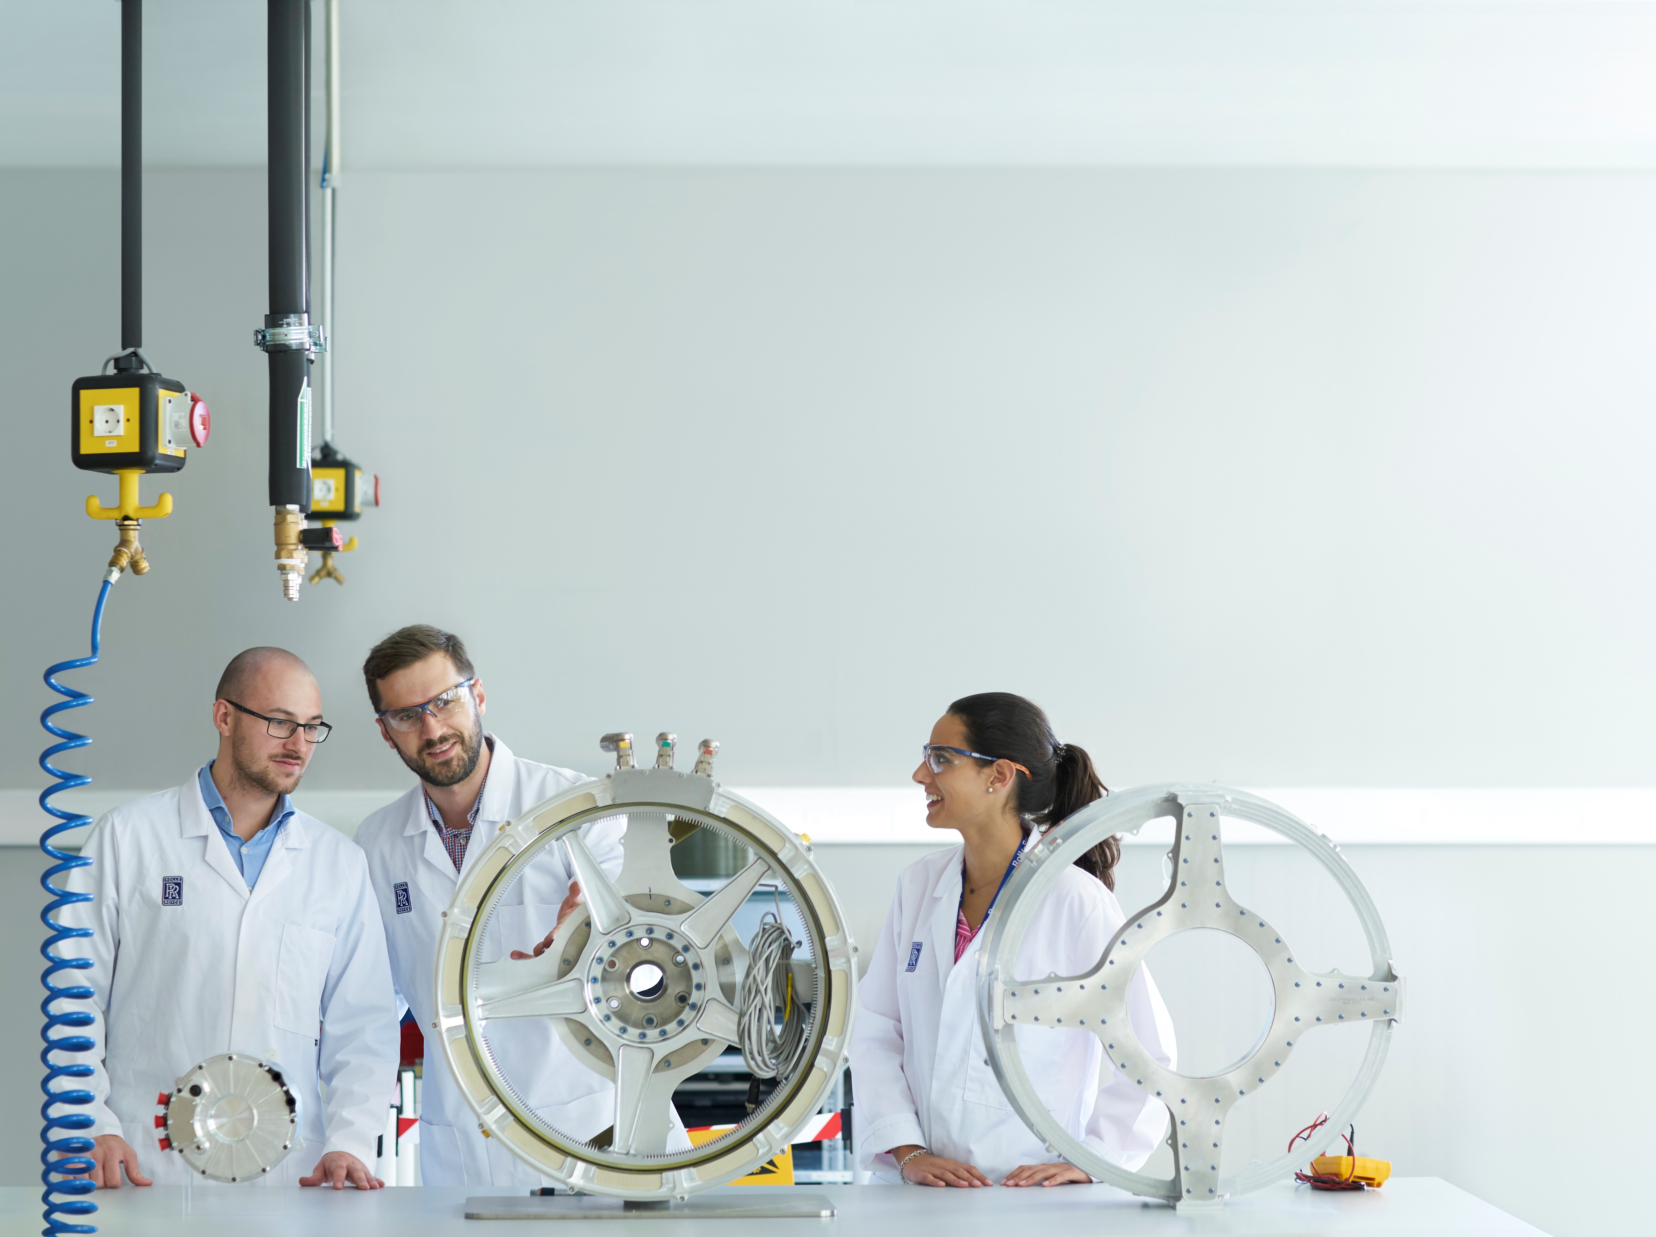
Pioneering new technologies to reach net zero by 2050.

Slide 8
Flying is the back bone of a modern, inclusive society.
We must find ways to continue to fly whilst protecting our planet’s fragile climate.
At Rolls-Royce we believe that aviation can be compatible with a net zero world.
We have the opportunity to reap the benefits of making aviation more sustainable.
In summary

