Slide 1
Dr Steve Melia
Senior Lecturer Transport & Planning
Decarbonising Surface Transport Through Traffic Reduction

Slide 2
2 Main Ways to Decarbonise
Surface Transport
Switch vehicles to non-carbon fuels (e.g. electric, hydrogen)
Reduce traffic volumes

Slide 3
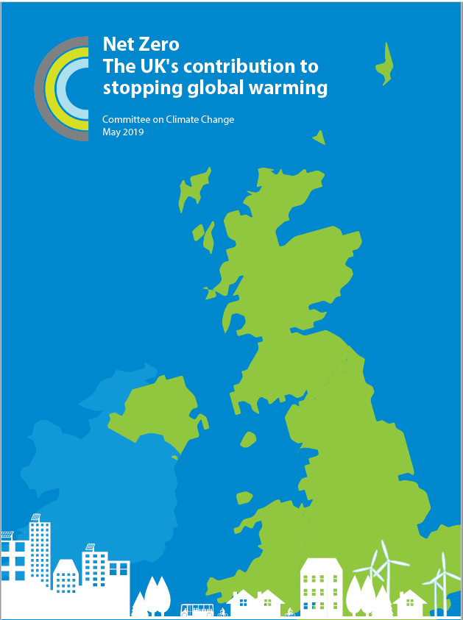


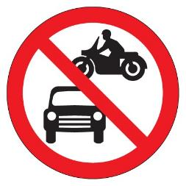
“Net Zero” = Absolute Zero for surface transport
Some CO₂ removal for planes
Not for cars or vans

Slide 4

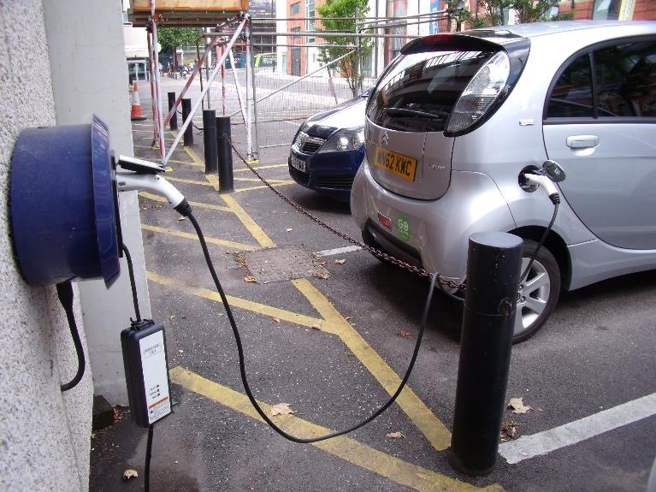
That means NO Petrol or Diesel Vehicles on road by 2050
So rapid electrification of cars and vans is unavoidable

Slide 5
Norway Leads on Sales of Electric Cars
Percent
Norway
UK

Slide 6
But Notice the Time Lag (Norway)
Percent
Annual Sales
Cars on Road

Slide 7
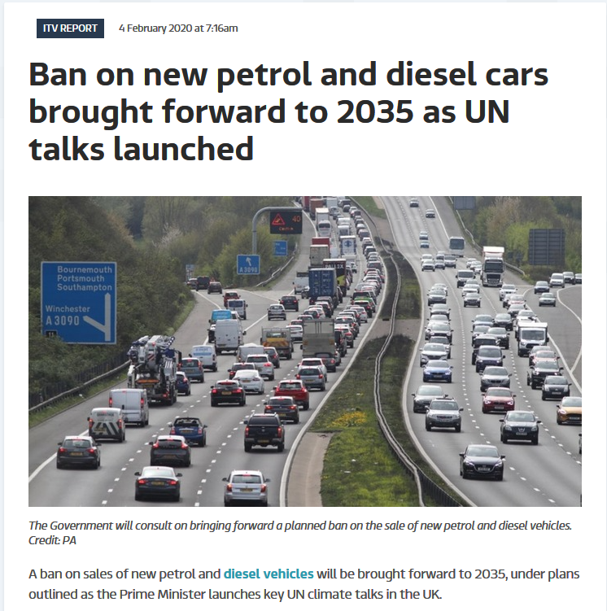
New Policy Intention:

Slide 8
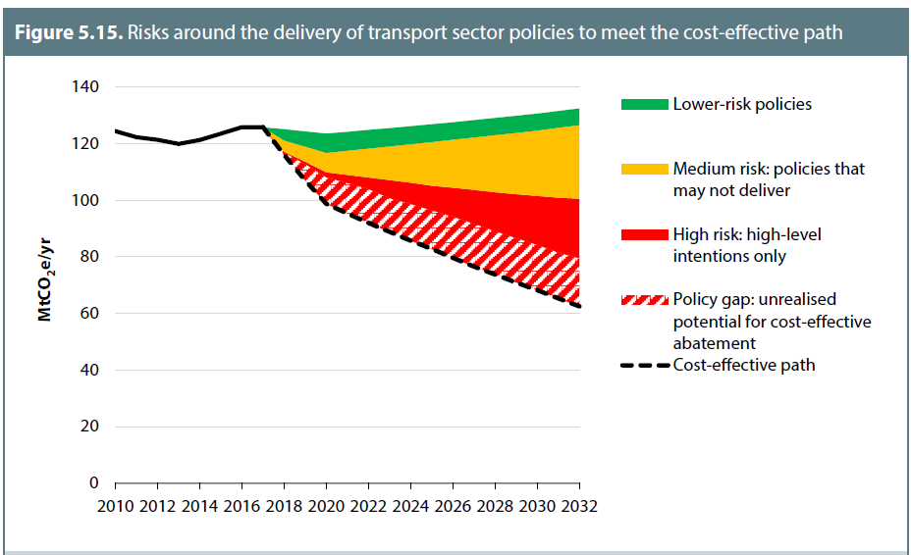
It’s Not Just About 2050 – It’s Also About How Quickly We Cut in the Meantime
UK Committee on Climate Change Assessment of transport policies

Slide 9
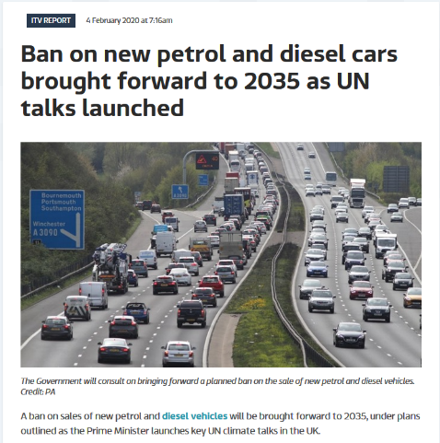
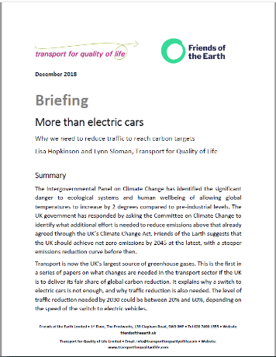
This Would Not be Enough on its Own
Initial Estimate:
If all new cars were electric by 2030
10% - 20% cut in car mileage needed by 2030

Slide 10
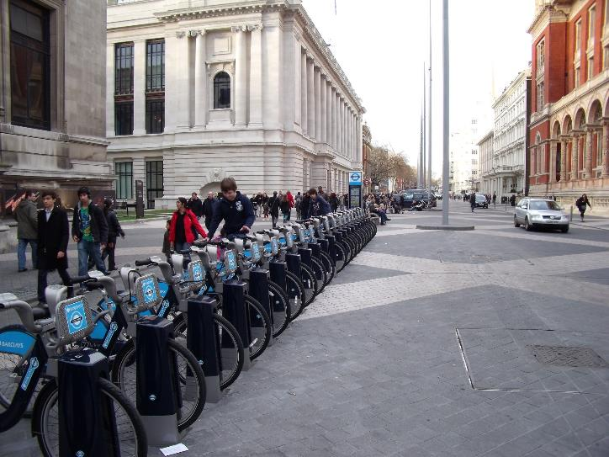
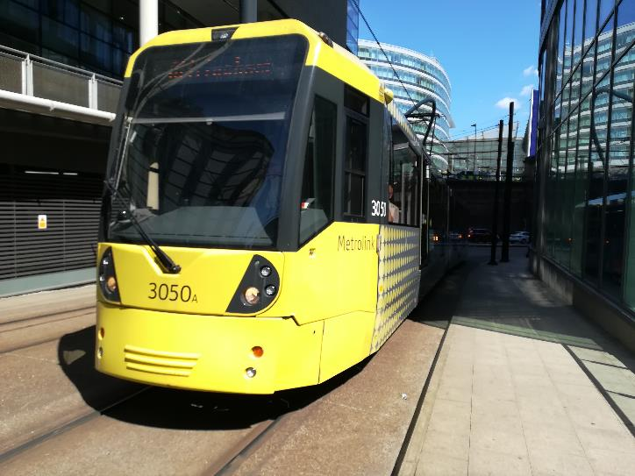
2) Reducing Traffic Volumes is easier
in larger urban areas

Slide 11
Modal Shift Example - London
Change in trips
Public transport
+56%
Other
Car
Source: Transport for London Travel in London reports

Slide 12
How Much Difference Did it Make?
Road transport emissions
– 5%
Traffic volumes
Sources: DfT Traffic Flows, Greater London Authority LEGGI

Slide 13
UK Population Still Forecast to Grow
Millions
Source: Office of National Statistics Forecasts

Slide 14
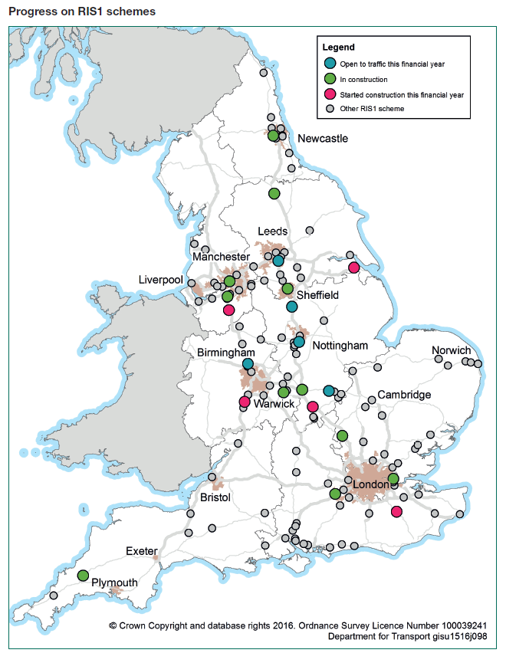
Budget:
£ million
Making the Problem Worse –
by Expanding Motorways and Main Roads
Year:
Source: Roads Investment Strategy (DfT, 2015)

Slide 15
Summary
2 Main ways to reduce emissions from surface transport
Faster electrification is essential.
We also need to reduce traffic volumes – this is easiest in larger urban areas
Population is growing – we should house more of the population in those large urban areas
Expanding the road network is making the problem worse and should be stopped

