Slide 1
In the home – introduction to panel 1
Jenny Hill
Committee on Climate Change
www.theccc.org.uk | @theCCCuk
@Jenny_C_Hill

Slide 2

In the home - what we will hear about this afternoon.
How difficult is it to get our homes to net zero emissions? Short answer – it is tricky (and we aren’t doing very well in the UK at the moment)
So what can we do? Some things we all agree on - others are less clear.
How much is it going to cost and who will pay?

Slide 3
Heating and powering 28 million homes uses ~30% of our energy
Most of the energy goes towards heating and hot water (grey & red on diagram)
We can build new homes now which use barely any energy …
…but most homes still standing in 2050 have already been built.
Net zero emissions means upgrading nearly all existing homes.

Slide 4

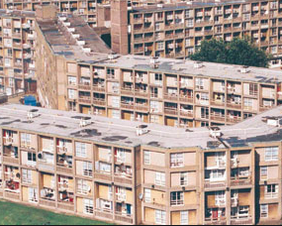

UK homes are relatively old and inefficient
Mainly gas-heated, but some use oil or electricity
Lots of older homes – a fifth built pre-1919
Around two thirds of people own the homes they live in – the rest are a mix of private-rented homes and social housing.
We need a mix of approaches for different homes and people
Notes:
Older homes are typically more expensive to insulate because they don’t have cavity walls
The rest are rented (with a mix of private landlords or local authorities / housing associations).
Mix of approaches – different solutions for different homes (for example new heating systems, new windows, different levels of insulation) and also different approaches for people (vulnerable or low income, whole people living in flats and terraces you might want to look at the whole block or street)

Slide 5
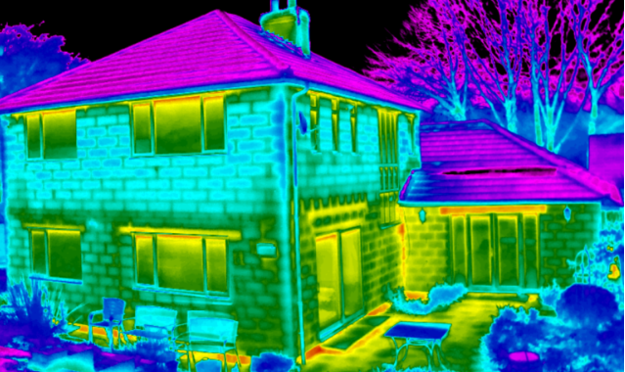

Insulating homes cuts energy bills, makes homes more comfortable and reduces emissions
We’ll cover the different ways of using less energy in the home.
Notes:
This is one of the big areas of agreement.
Nick Eyre is going to talk to us first about some of the easier and lower cost insulation measures like loft insulation and draught-proofing. These will typically ‘pay back’ within a few years through lower bills.
He’ll also cover some other interventions take longer to pay back and can be more disruptive.
Major benefits – helping bring people out of fuel poverty by making it affordable to heat their homes properly.
There are big potential saving to the NHS (£1.4B -2.0B/yr in England alone).
However, there is a limit to how far you can go with existing homes before it starts getting prohibitively expensive and doesn’t pay back. This is why we need to also look at heating for existing homes.

Slide 6
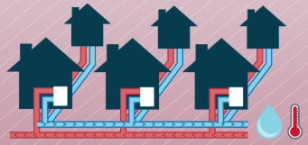
Many homes in cities could be connected up to district heating systems
Hot water is piped between homes
“Central heating for cities”
Zero-carbon heating can be done at relatively low cost
Could be the best fit for up to 5 million homes
Notes:
Another area where there is fairly good agreement among experts is…
Relatively low cost – i.e. comparable with the cost of gas heating now
Must make sure that adequate consumer protection is in place so that people don’t get overcharged and get a good service.

Slide 7
Electric and hydrogen heating are two of the big options being discussed.
Both are likely to lead to higher heating bills
Could be combined in the home (e.g. ‘hybrid’ technical solutions)
You could also see different solutions in different parts of the country
Notes:
At a very high level, [title]
We’ll hear from two different speakers who will cover we could tackle the remaining emissions from using fossil fuels for heating, hot water and cooking – including some of the challenges involved.
Richard Lowes will look at electrification
Chris Clarke will then cover hydrogen
Want to stress that this is an evolving area – there are big uncertainties around costs and how you might produce hydrogen in a low-carbon way. We want to give you a flavour of the debate and are interested in your reactions, but we are unlikely to solve this over the next few sessions together.
Other solutions like solar heating can play a role as part of the mix (we won’t be able to cover everything, but there will be plenty of scope for questions)

Slide 8
www.theccc.org.uk | @theCCCuk
@Jenny_C_Hill
Notes:
So next we will hear from Nick Eyre, who will talk about how to make our homes more efficient, and how we can reduce the amount of energy we use. Then we will hear two different perspectives on zero carbon heating.

