Slide 1
Reducing Energy Demand in the Home
Climate Assembly UK
Birmingham, 8th February 2020
Nick Eyre
Centre for Research in Energy Demand Solutions
Environmental Change Institute
University of Oxford
Notes:
CREDS is the Centre for Research into Energy Demand Solutions. We study how to use energy better. How to make our lives better, whilst using less energy not more.
And it’s important to emphasise that we have been making progress in using energy more efficiently for some time. Of the 40% reduction in emissions, most of that has been due to using energy more efficiently.
This is true across all the ways that we use energy. But I have been asked to focus on how we use energy in our homes.

Slide 2
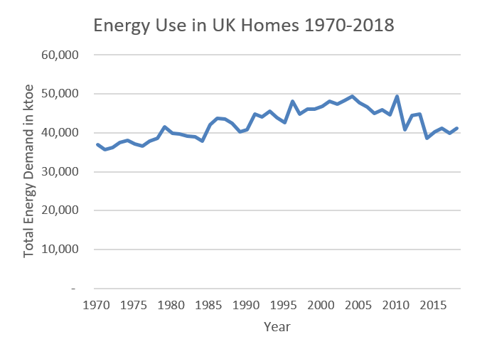
Trends in Energy Use in UK Homes since 1970
Notes:
This graph shows energy use in our homes since 1970. It’s higher in years with cold winters so it goes up and down a lot. But the recent downward trend is clear. Energy use has fallen by about one fifth since 2004.
At the same time, we have more homes, warmer homes and more energy using gadgets than ever before. Those changes have been outweighed by using energy a lot more efficiently, due to insulation, better boilers, and efficient lights and appliances
Most major changes have been driven by Government policies like regulation and incentives. But you can see that the rate of improvement has slowed in recent years as Government support and incentive for energy saving have been reduced.
I am going to talk about 4 ways we can reduce energy use in our homes.

Slide 3
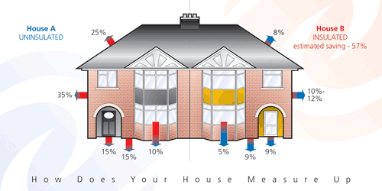
How can we reduce energy demand further? 1. Increase home insulation
Insulation reduces heat loss and therefore the amount of fuel purchased to keep the house at a comfortable temperature
Notes:
The first is by increasing insulation.
Houses lose energy through the roof, walls, floor, windows and doors. All these losses can be reduced by better insulation and reducing draughts.
Insulation reduces heat loss and therefore the amount of fuel purchased to keep the house at a comfortable temperature
Every house is different, but moving from poor insulation to a good insulation roughly halves heating bills.
Many of our homes now have basic insulation measures – loft insulation, insulation walls with cavities, and double glazing.
The early priority should be to address the homes that don’t already have these, which might reduce energy use by a further 5-10%.
Larger savings will be more difficult. They will need measures like insulation of solid walls and floors. These are more expensive and often need more disruptive building work.
So the key questions are: how much high cost work should be done? When is the best time to do these? Who should pay?

Slide 4
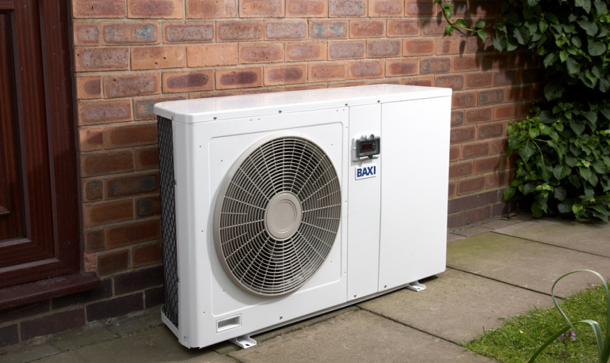
How can we reduce energy demand further? 2. Increase heating system efficiency
From boilers..
…to heat pumps
Notes:
The second thing we can do is improve the efficiency of our heating systems.
Most homes now have a condensing boiler, which is much more efficient than older boiler types, because they capture more of the heat from the hot gases that go out of the boiler flue. This has been a major success story.
But it’s possible to do a lot better by moving away from boilers to more efficient systems like heat pumps. Boilers use fuel by burning it. Heat pumps use fuel to pump heat from outside the house. So they reduce the amount of fuel needed to produce the same amount of heat. Potentially by a lot! A good electric heat pump will provide three times more heat than just using a simple electric boiler or heater.
Heat pumps can be powered by a range of different fuels, including zero carbon fuels (like renewably-produced electricity and hydrogen).
So moving to next generation heating technologies is important for climate change and for household bills.
But it will involve changing heating systems in all our homes, at the same time as moving away from natural gas as a fuel. So it will be a massive change. It cannot be done quickly. The heating industry really needs to be geared up for it, and we haven’t made much progress yet. Much less than some other countries like Germany, France and Sweden.

Slide 5
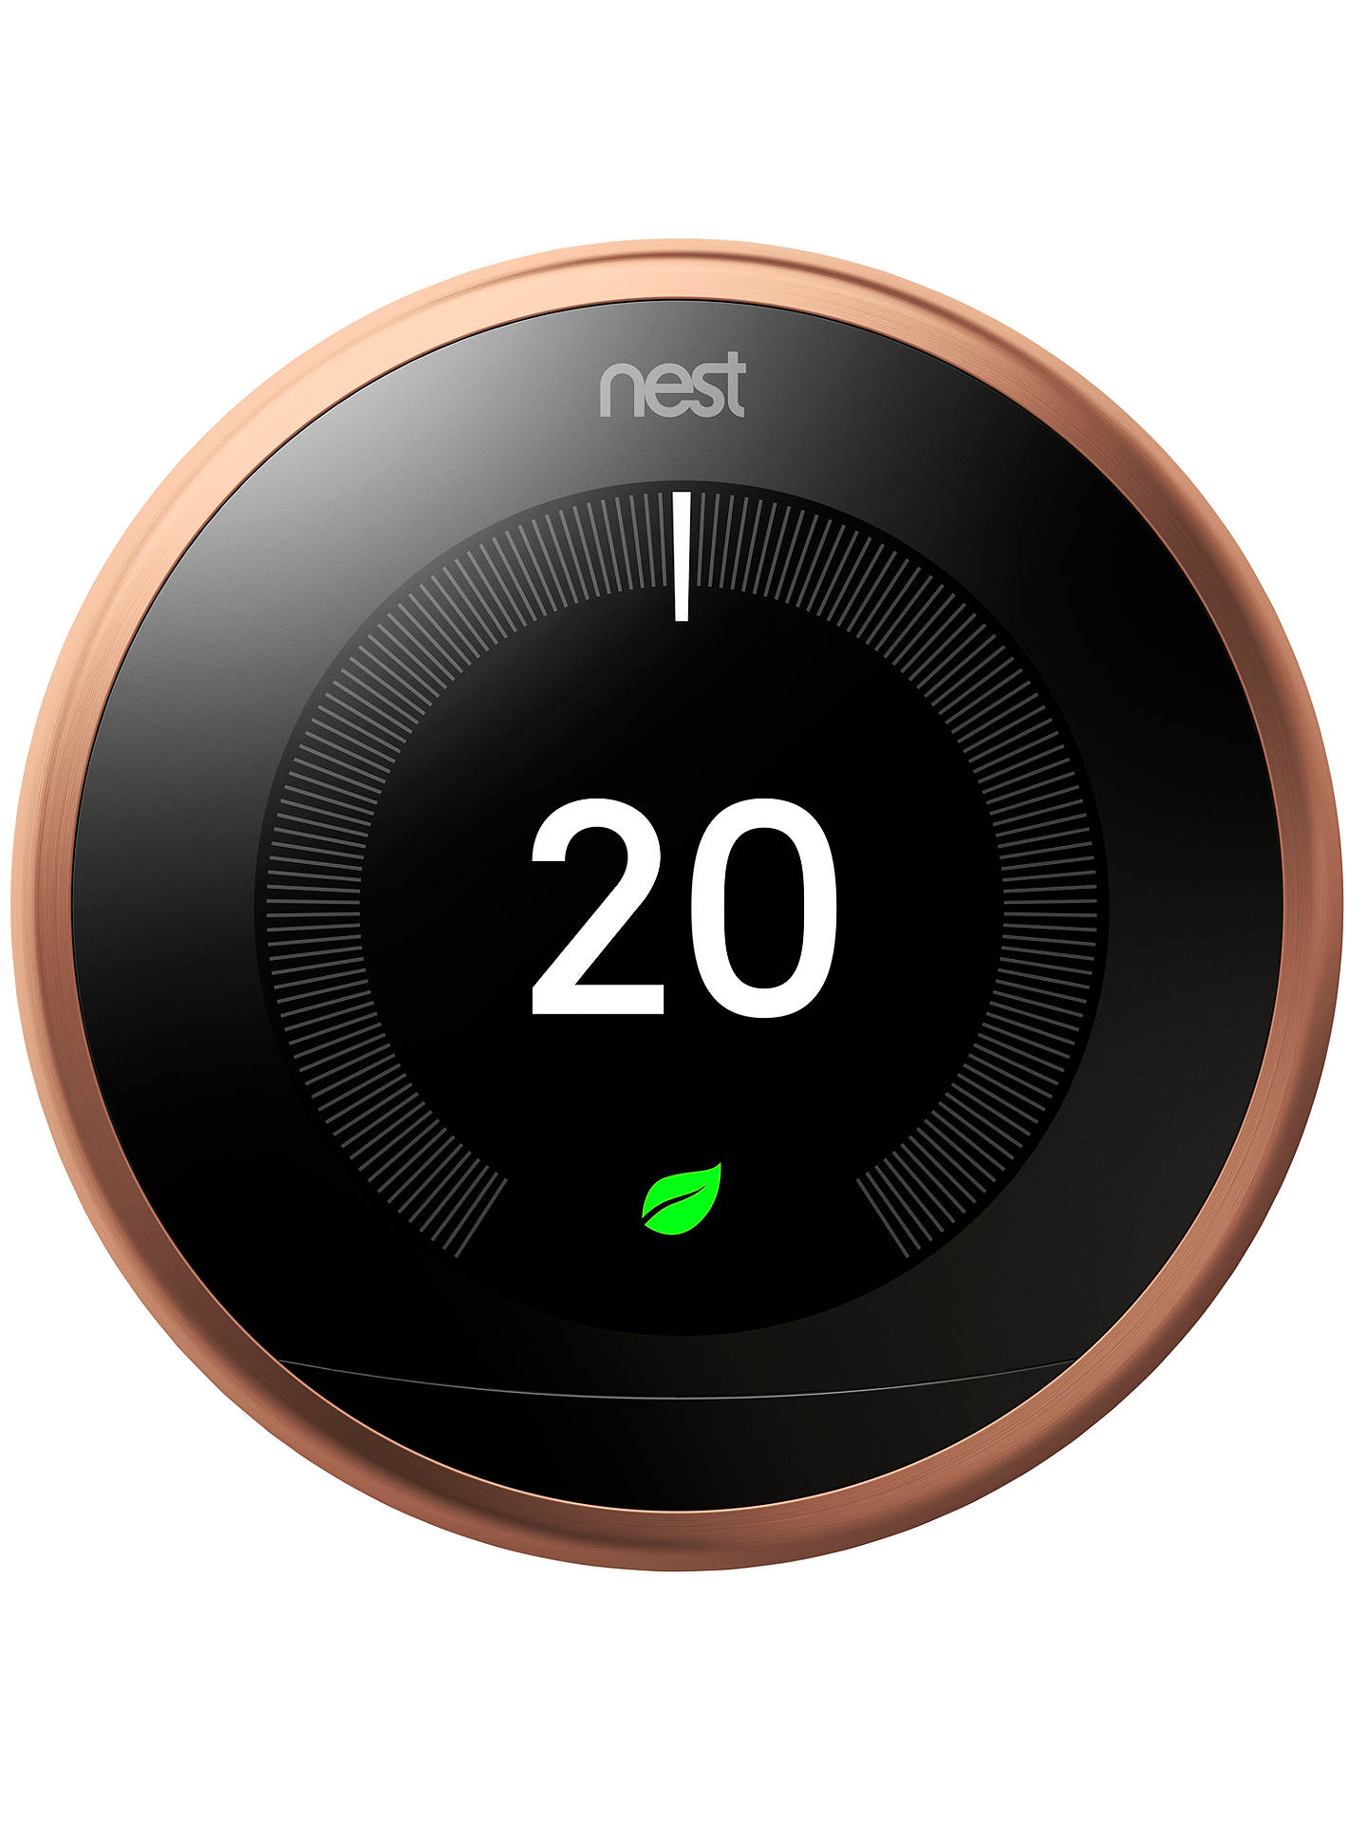
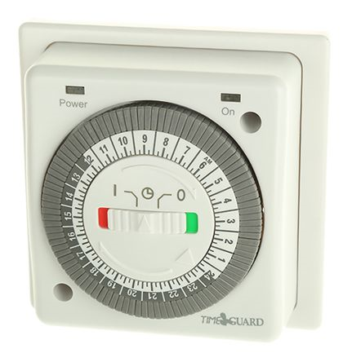
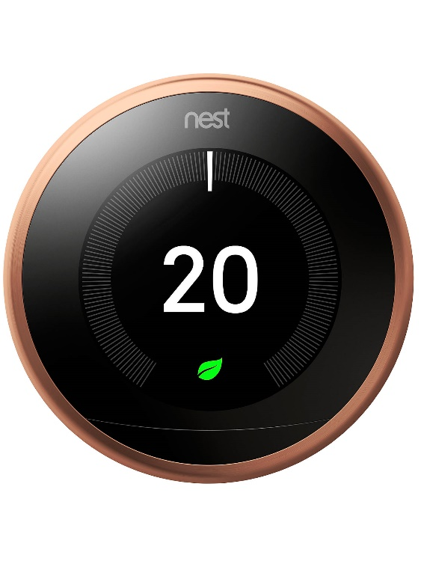
How can we reduce energy demand further? 3. Reduce temperatures in homes
Notes:
The third thing we could do is reduce the living temperature. Each 1C reduction in temperature saves 10% on heating bills, so there are real financial benefits, as well as environmental benefits if we can do it.
But it is not without problems. Many people still live in homes that are too cold. There are health implications for vulnerable people of living in cold conditions, so this isn’t a good idea in their homes.
But healthy adults can live certainly in cooler conditions than most of us do.
There is general agreement that we should reduce temperatures where building are too warm. The easiest way to do this is through better controls. We have already achieved quite a lot with basic controls like thermostats, timers and radiator valves.
New technologies like ‘smart thermostats’ are beginning to be widely deployed. These can definitely help if used well.
One other approach would be to use clothing better (mainly for people not just dogs!). Putting on an extra jumper is an easy thing to do. And modern clothing technology like fleeces are much less bulky than old-fashioned clothing.
Could this become fashionable? I’m not a fashion expert, so I don’t know. But if we are thinking about changing how we travel and what we eat, it seems like a question that’s worth asking.

Slide 6
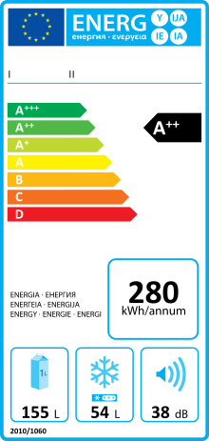
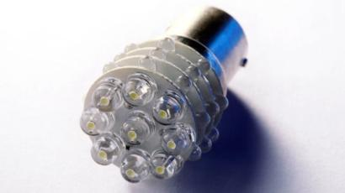
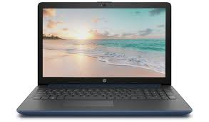
How can we reduce energy demand further? 4. Reduce electricity use in lights and appliances
Notes:
So far I have concentrated on heating because 4 fifths of the energy we use in homes is for space heating and water heating. The rest is split roughly equally between cooking, lighting, refrigeration, washing machines and electronics.
There are ways we can use less energy in all of these. The most important is by buying energy efficiency products.
Here too, we have been making progress. Energy use in lighting is about half what it used to be due to the use of efficient lights like these LEDS – they use about one tenth of the electricity of an old tungsten light bulb.
Most large appliances – fridges, washing machines, TVs – are also now much more efficient than older appliances. The EU energy label (like this one) identifies the best products to buy, and increasingly product standards have banned the worst products. But there is more to do and government needs to continue to use strong regulation to stop inefficient products being sold.
The fastest growth area is in consumer electronics and computing. But the good news is that even in these areas, energy use has now stabilised as better products have been required.
In conclusion, we know how to reduce energy use in our homes. And some of it, like buying the most efficient products, we can do fairly easily. Other changes that we need will be more difficult – things like insulating old houses and changing heating technologies. But it needs to be done if we are to reach zero emissions.

