Slide 1
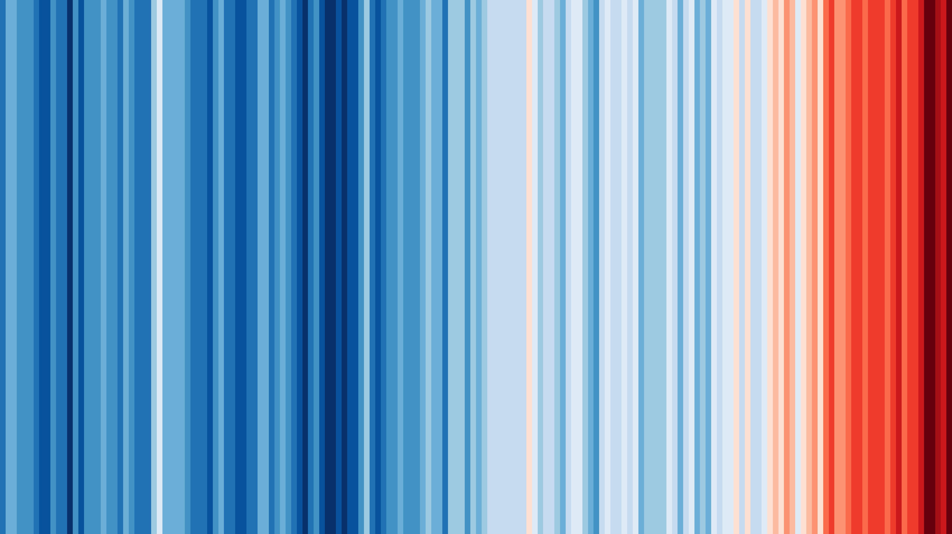
Global temperature change from 1850 to 2019
www.showyourstripes.info

Slide 2
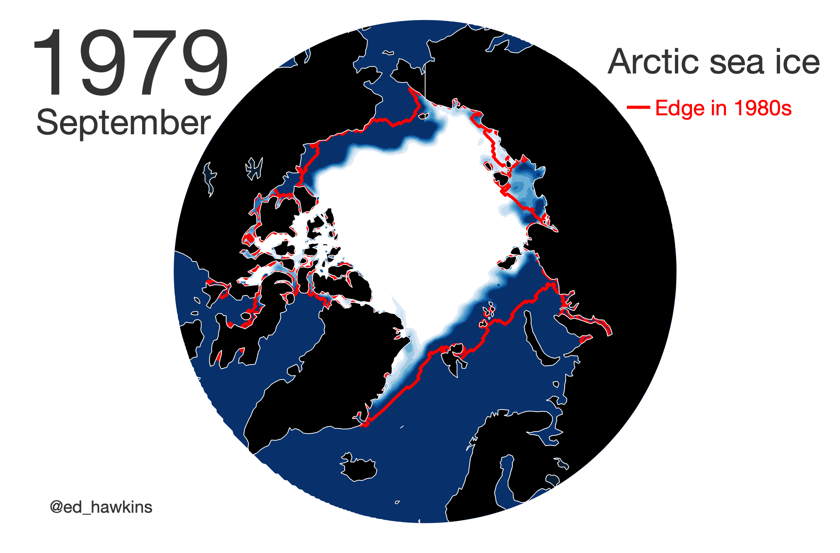

Slide 3
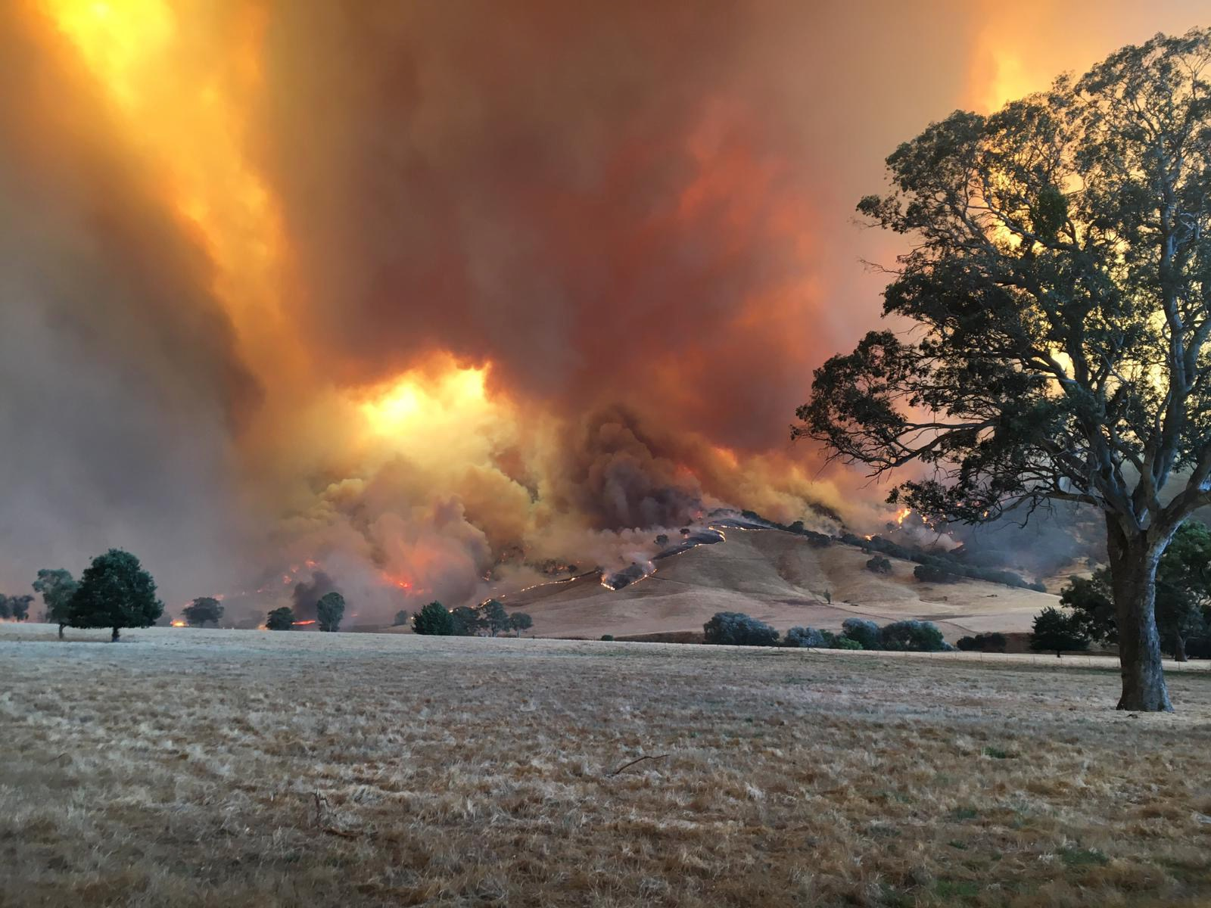

Slide 4
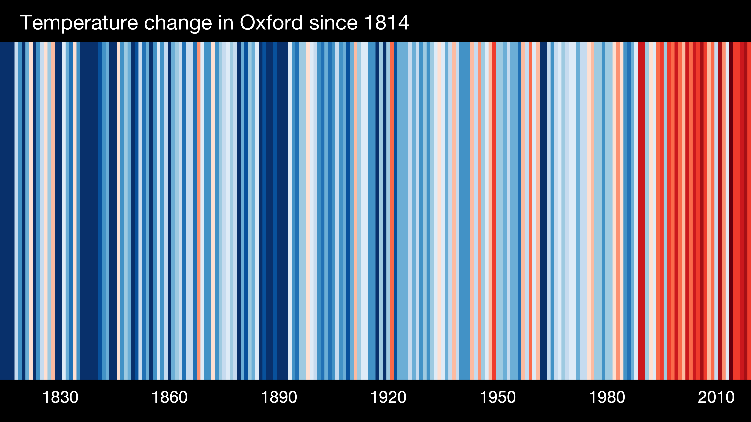

Slide 5
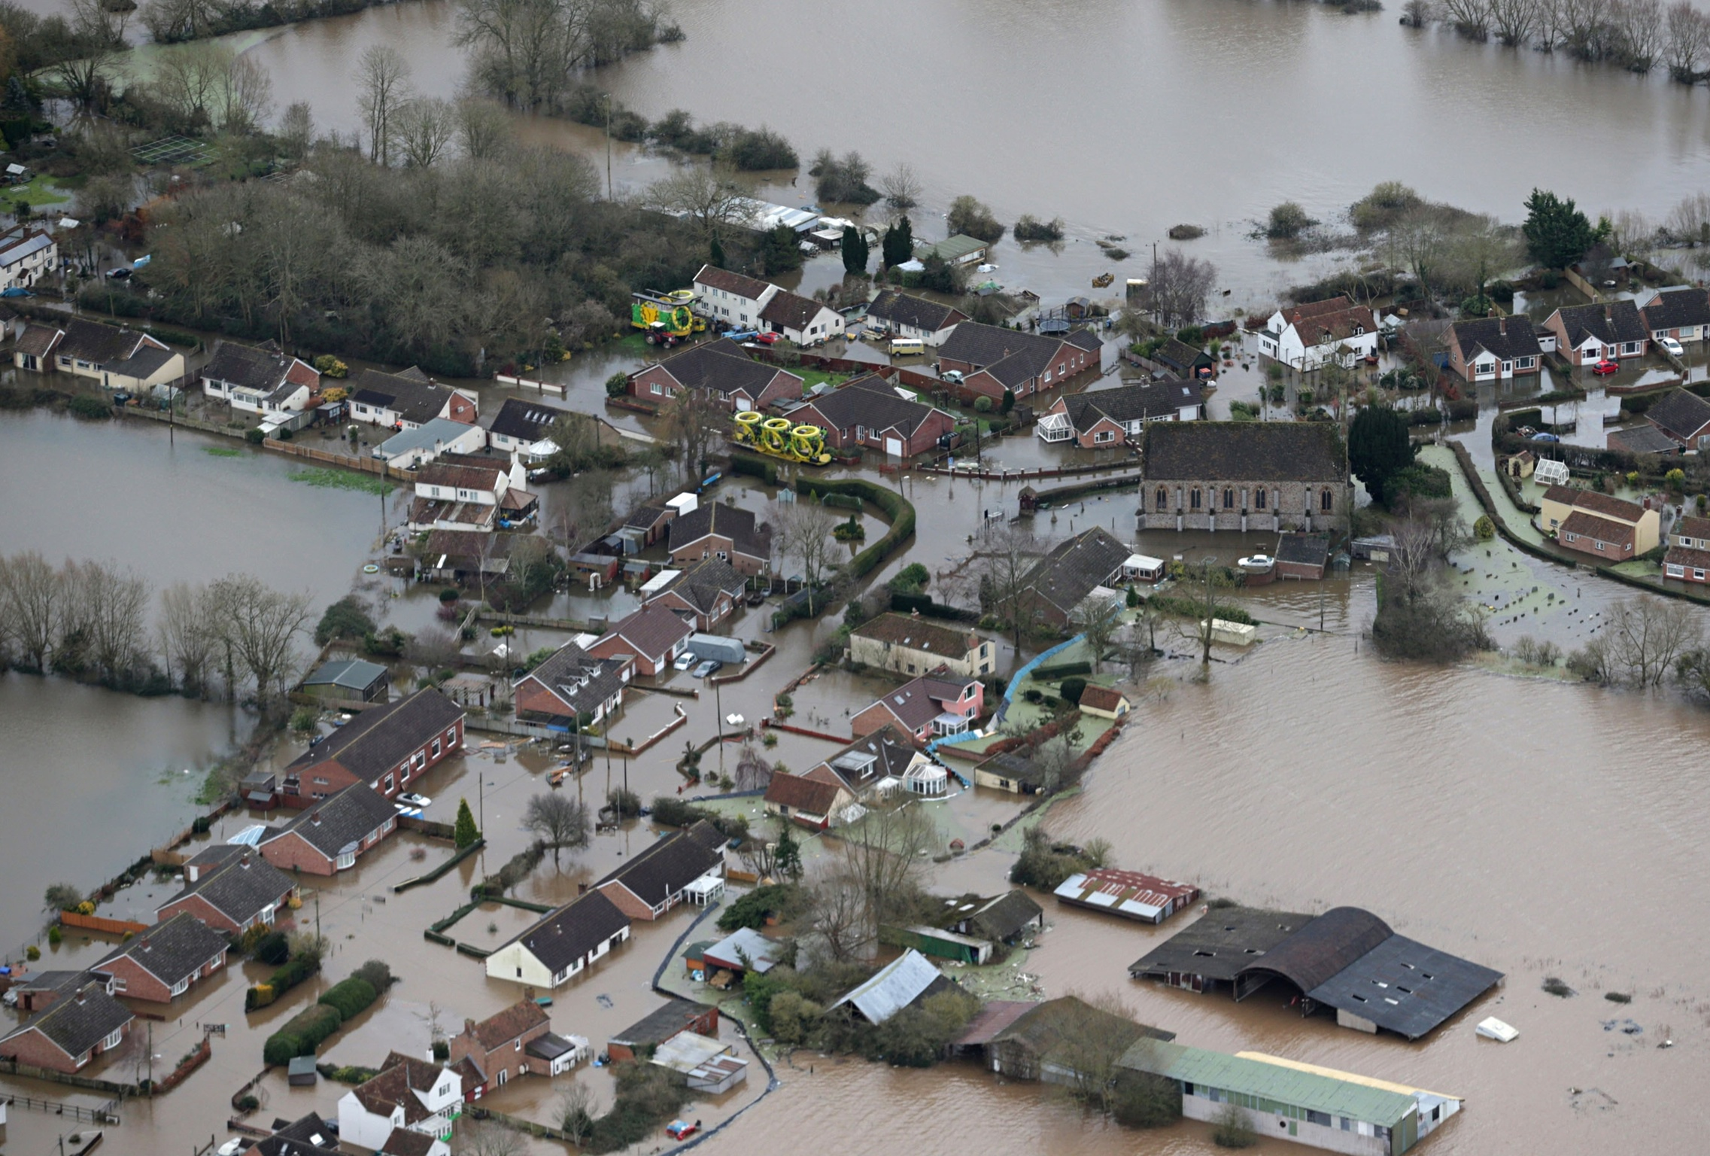

Slide 6
risks
coastal erosion
species extinction
migration
glacier loss
ocean acidification
sea level rise
food insecurity
storm surges
droughts
coral bleaching
floods
wildfires
heatwaves
water scarcity
fishery shifts
disease movements
ocean circulation changes
infrastructure failures
Notes:
Climate not only factor in all of these, but contributor

